Slide 1
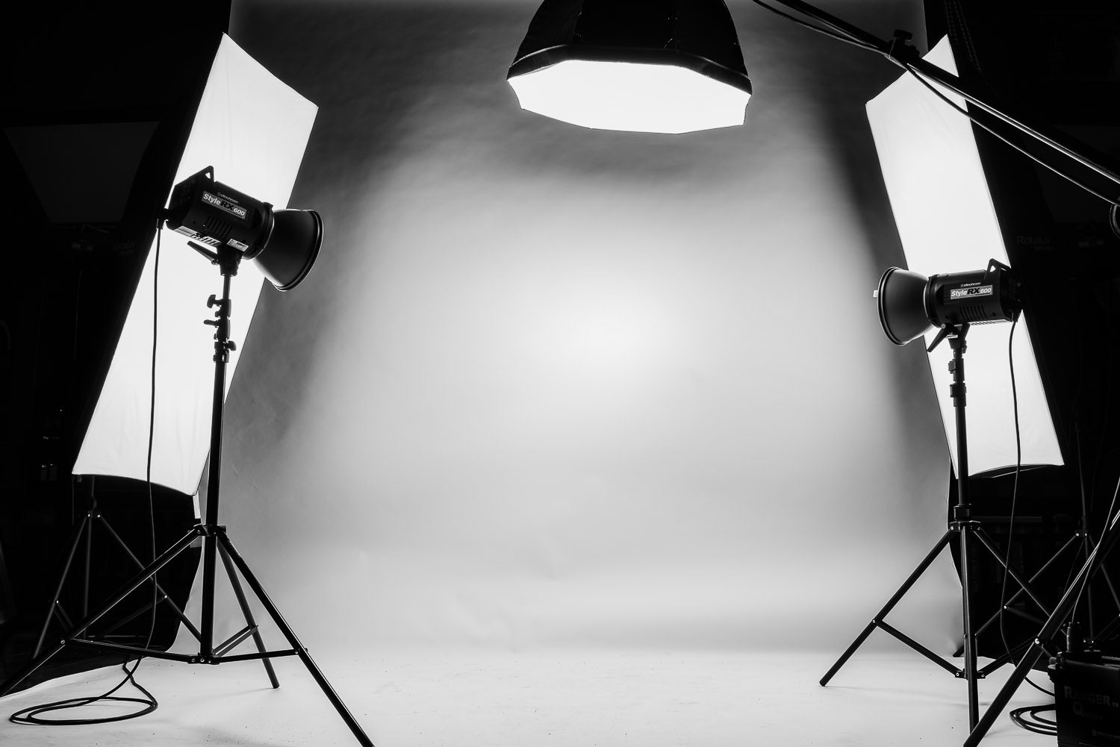

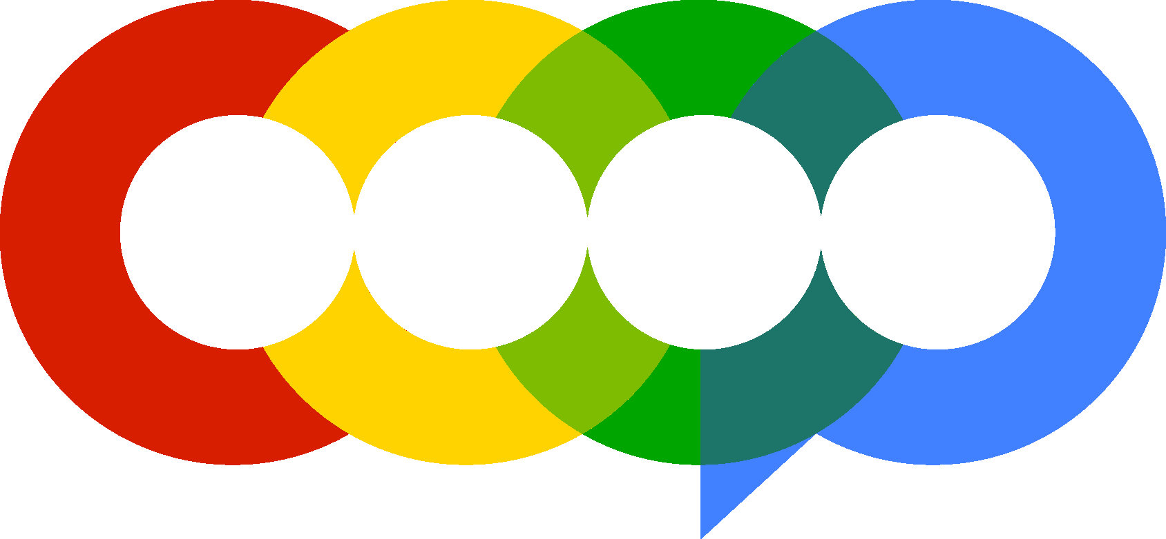
Blank Space Studio
Strategies to Increase Engagement and Sales
C290
Cohort 290 Lionel Amilca, Samantha Botros, Mariama Diallo, Jessie He, Jessie Lin, Tashi Palden, Christelle Samedi,
Cassharese Smith, Marco Wu, Yu Xuan Yang
Notes:
Lionel

Slide 2
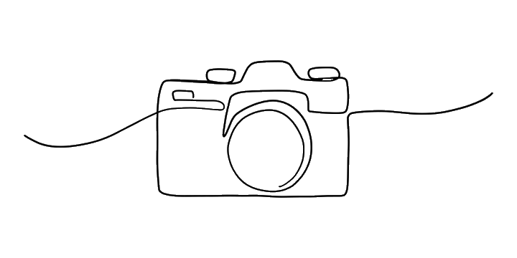
Overview
Analysis
Engagement Strategies
Revenue Strategies
Conclusion
Agenda
Notes:
Lionel

Slide 3
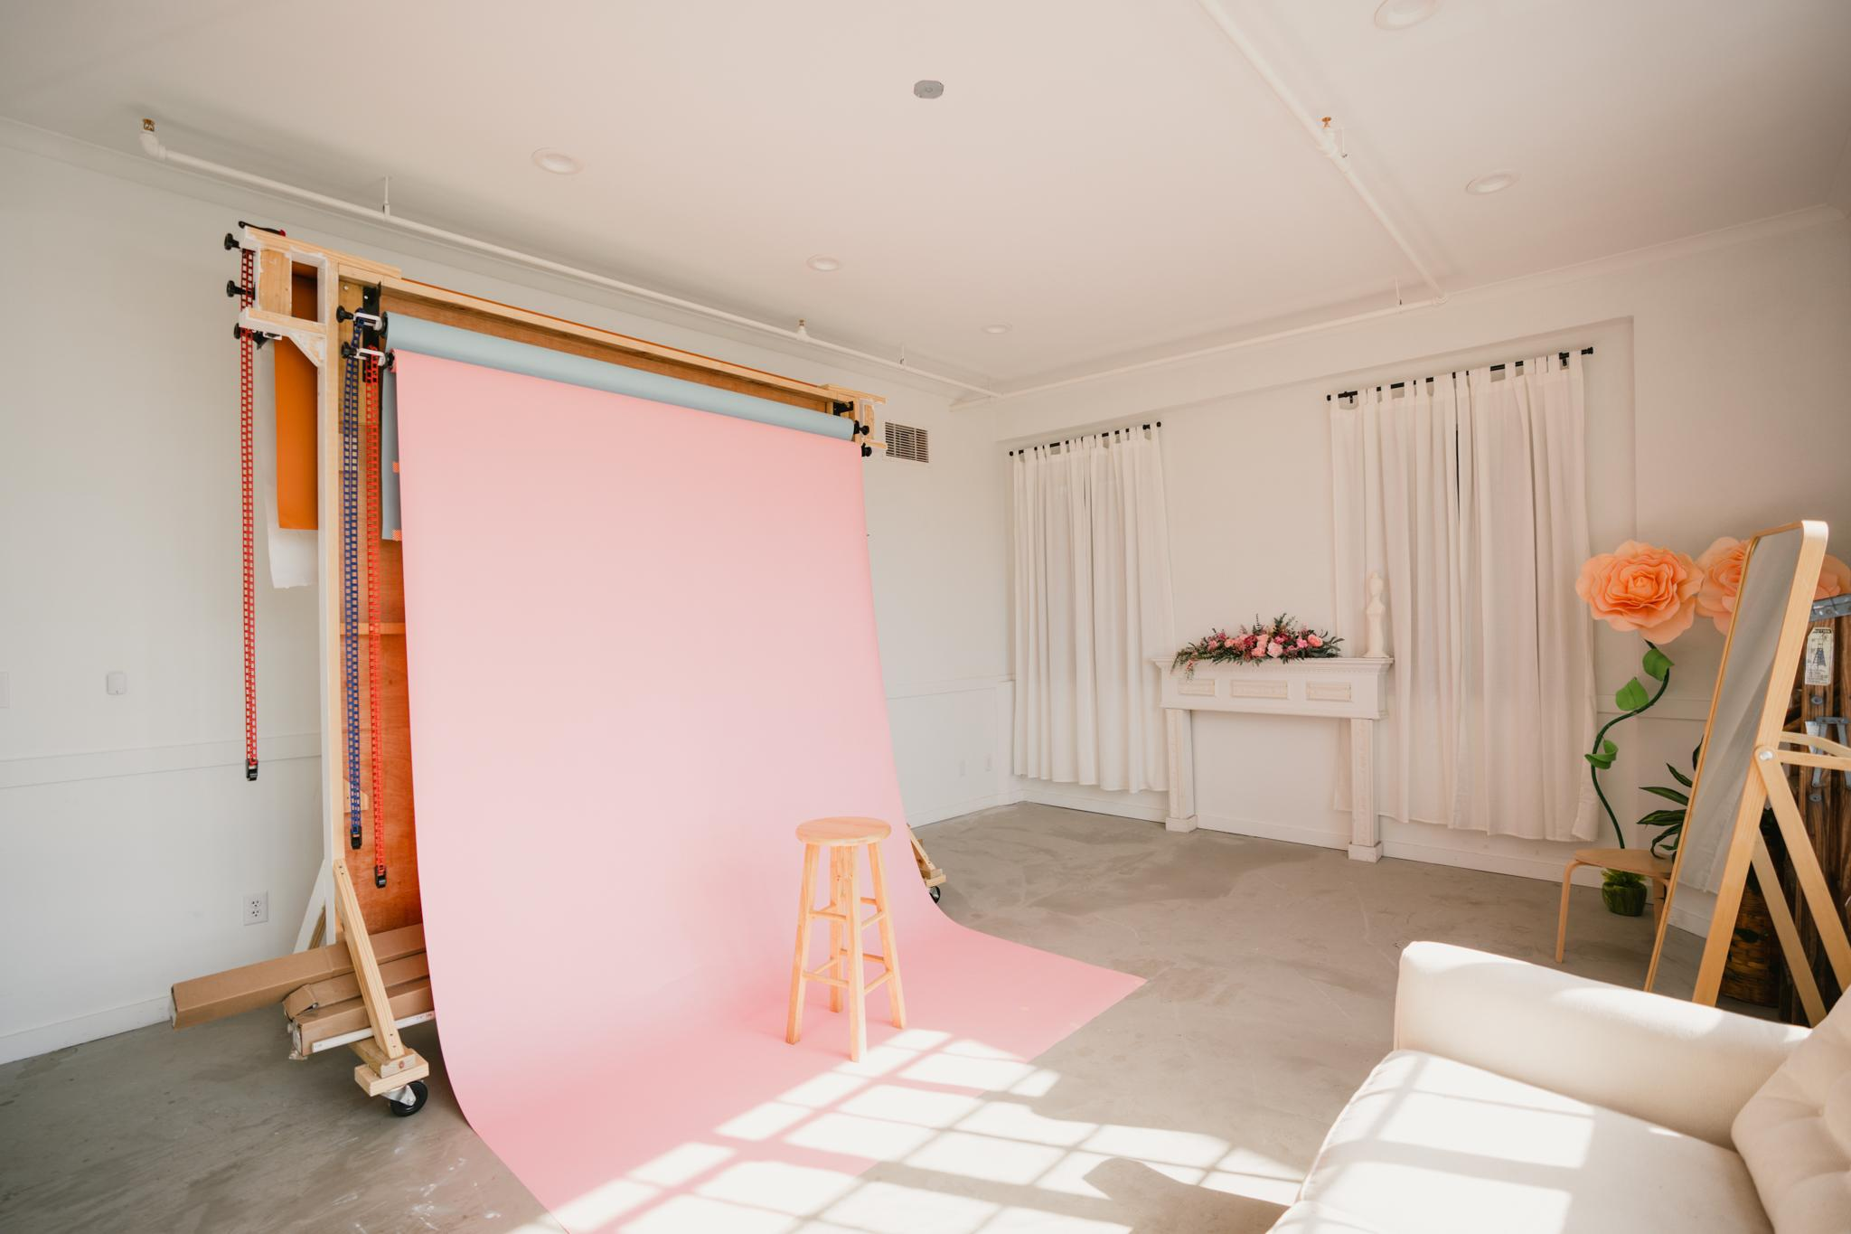
Overview
Notes:
Lionel

Slide 4
Profile target audience
Identify strategies to increase sales/conversions and areas of growth for future promotions
Identify existing business policies and structure
Visualize and analyze bookings and their sources
Objectives & Goals
Notes:
Lionel

Slide 5
Meta Analytics:
Facebook
Instagram
Squarespace
Peerspace
Personal log of studio usage
Data
Notes:
Lionel
Mention Dataset contains data from August 2022 to April 2023

Slide 6
Analysis
Notes:
Lionel

Slide 7

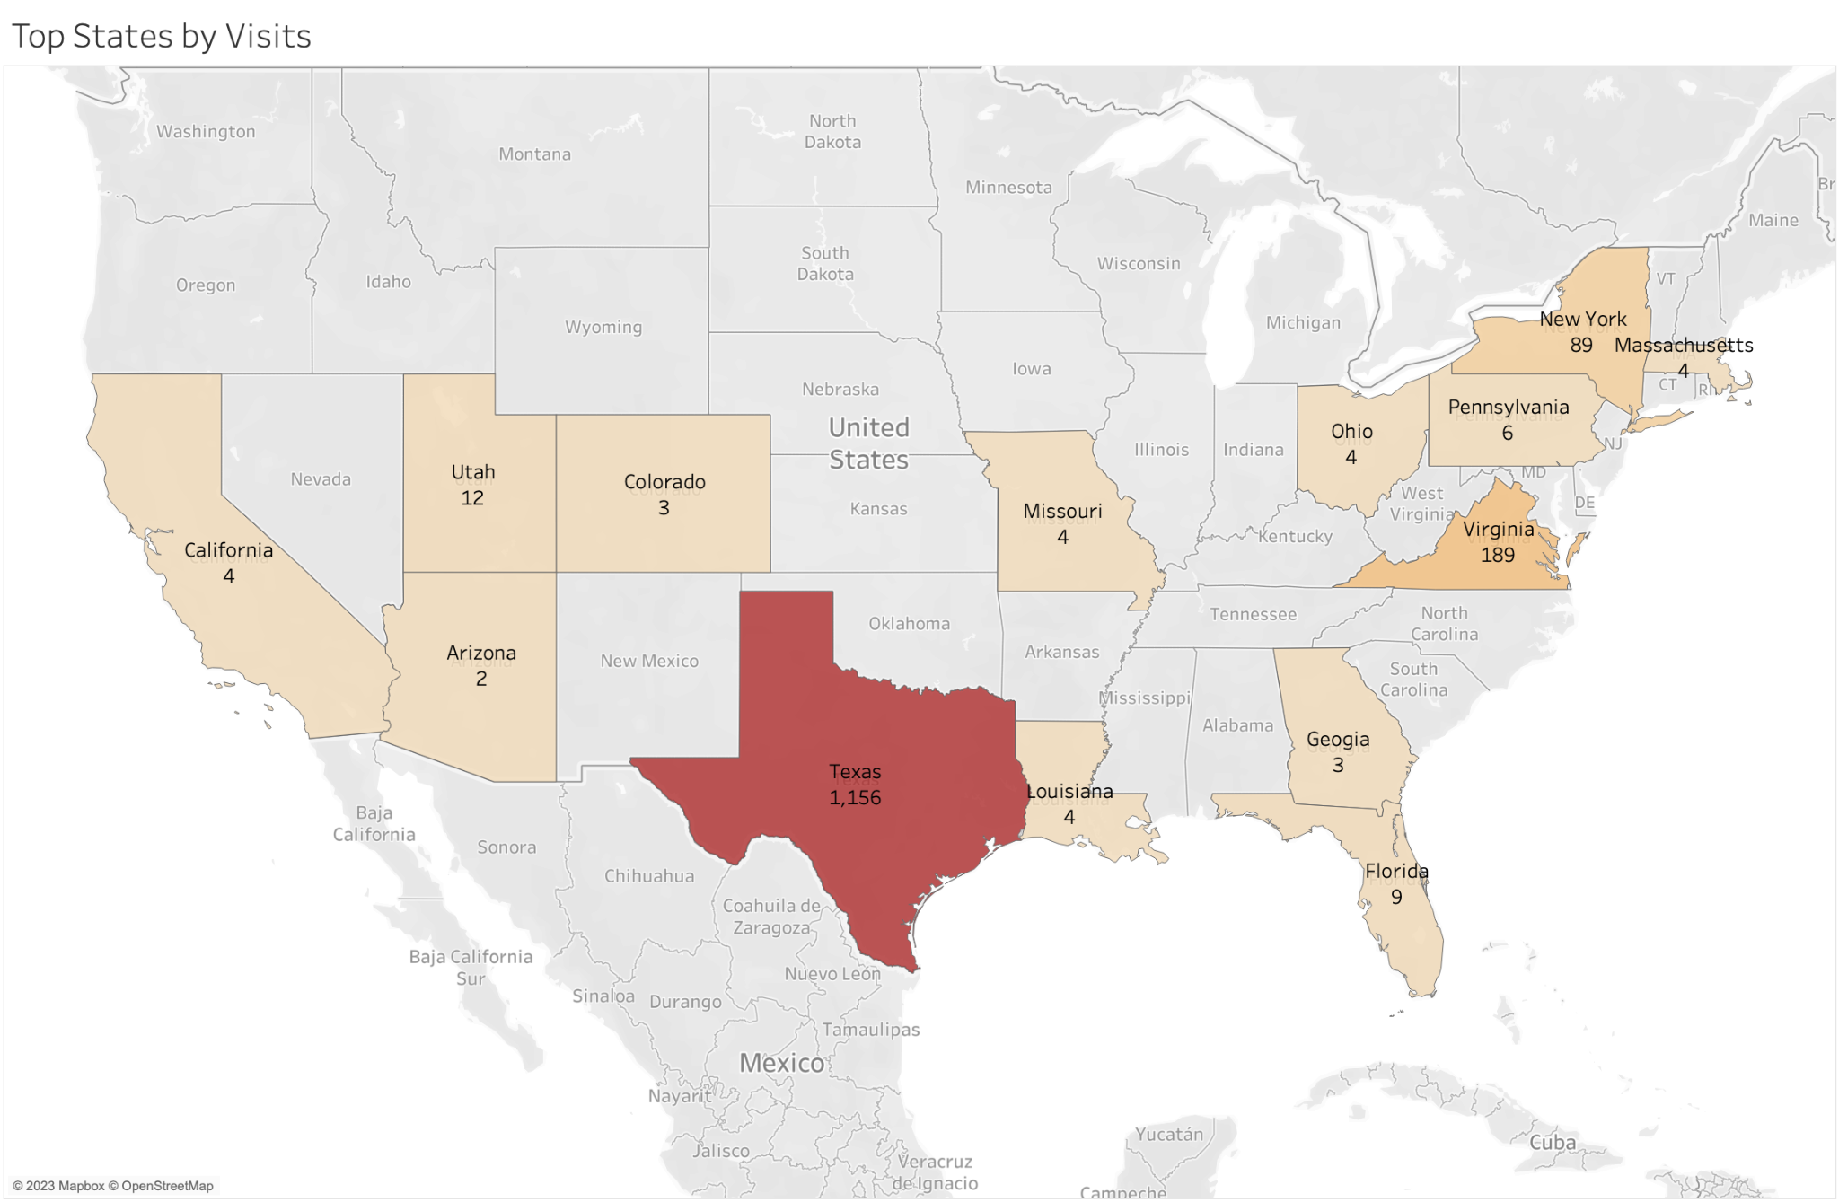

Observations/Insights
Texas brings in the most visitors
Virginia have the second highest visitors
New York have the third highest visitors
Top States by Visits
Created w/ Tableau
Notes:
Shawn
This map provides an overview of top states by visits across the United States.
As the location of headquarters, Texas brings in the highest visitors, making up the largest percentage of total visits
Virginia ranks second and New York places third for visits, suggesting potential interests from the East Coast area

Slide 8
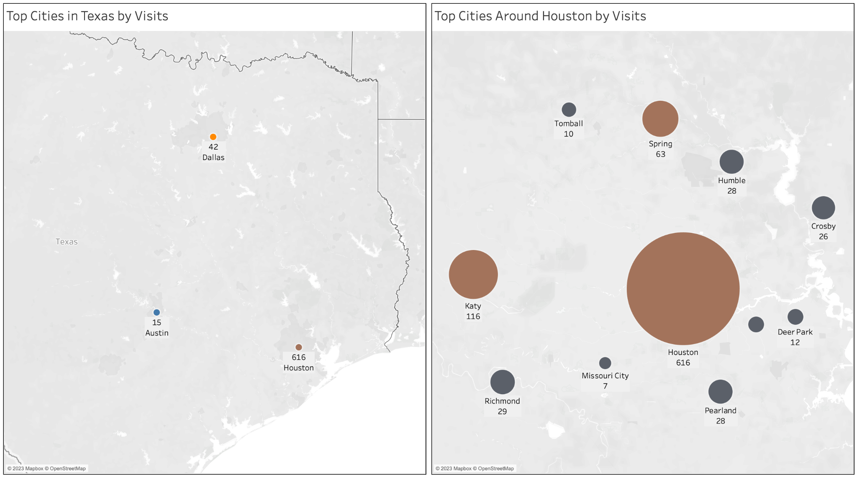
Observations/Insights
Houston brings in the most website visitors
Nearby cities close to the studio also bring in visits
Visitors by Location
Created w/ Tableau
Notes:
Shawn
The graph on the left provides an overview of the top cities in Texas by visits
Aside from cities around Houston, one interesting finding is that there are some visits from Dallas and Austin, which are located far away from Houston.
This indicates potential interest in the renting studio from further locations across Texas.
The graph on the right shows the top cities around Houston by visits. As expected, Houston is the top on the list, as the studio is located in Houston. Katy ranked second and Spring third. These cities are likely potential customers living within close proximity

Slide 9
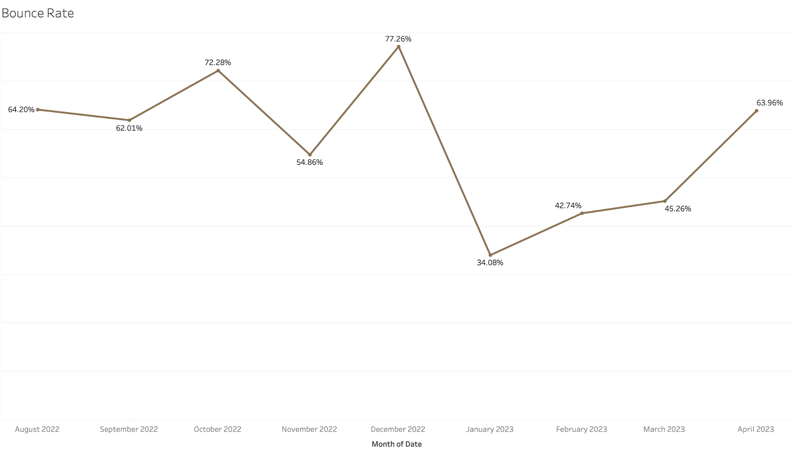
Observations/Insights
Fluctuating bounce rates but still quite higher than average
Highest bounce rate website experienced: January 2022
Lowest bounce rate website experienced: January 2023
Good number to maintain as it’s between average
Bounce Rate
Created w/ Tableau
Notes:
Mariama: Hi Jen, a few weeks ago I spoke to about bounce rates as it relates to your website. Today I will just be reintroducing the topic to you and explain why it’s important and relevant to your photography business. What is bounce rate? Bounce rate is the percentage of users who leave a website after viewing only one page.This page can be any page to which they are first directed to (such as the home page, residency page or membership page).
Bounce rate is important because it is a way to inform you about how engaged your users are with your website. Generally, when someone access your website for the first time, you want them to spend a good amount of time navigating throughout and learning more about your services and not leave the moment they access the page. We see that from Aug 2022 to Oct 2022, your bounce rate was quite higher than average which average is (20%-40%). Then there was a 17.42% drop in November 2022. With the data and information you provided us, were able to conclude the reason for drops in bounce rates for November and January was due to the ongoing promotions you were advertising during those months. Your website did its best in January in maintaining a good average bounce rate, which is great! This basically means more users were engaged with your website because the promotions you were having at the time was of a great interest to your audience. Hence, engaging in more advertising efforts consistently for your business and enhancing your website layout and content is a great way to help reduce your website bounce rate performance and increase user engagement.
To sum up, high bounce rates suggest that your website user engagement is quite low as people are leaving your website the minute they land on it. Low bounce rate is good because it means users are visiting more than one page after accessing your website.
1. Improve website loading speed - A fast loading website can increase user engagement and reduce bounce rates.
2. Enhance website layout and content - High-quality content and an intuitive website design enhance engagement and help retain users on the website.
3. Make website mobile-friendly - Make sure the website is optimized for mobile devices, as an increasing number of people access websites through their smartphones.
4. Optimize website navigation - Easy and intuitive website navigation makes it user-friendly and guides visitors through your site.
5. Ensure website is secure - A secure site with HTTPS protocol improves users' trust in your site and keeps them on it.
6. Target website content - Understand the website’s target audience and design content that caters to their specific needs and interests.
7. Enhance search engine optimization (SEO) - Optimize content to align with user search intent, resulting in a lower bounce rates.
By implementing these strategies, businesses can improve user experience and engagement on their website, leading to a reduction in bounce rate.

Slide 10
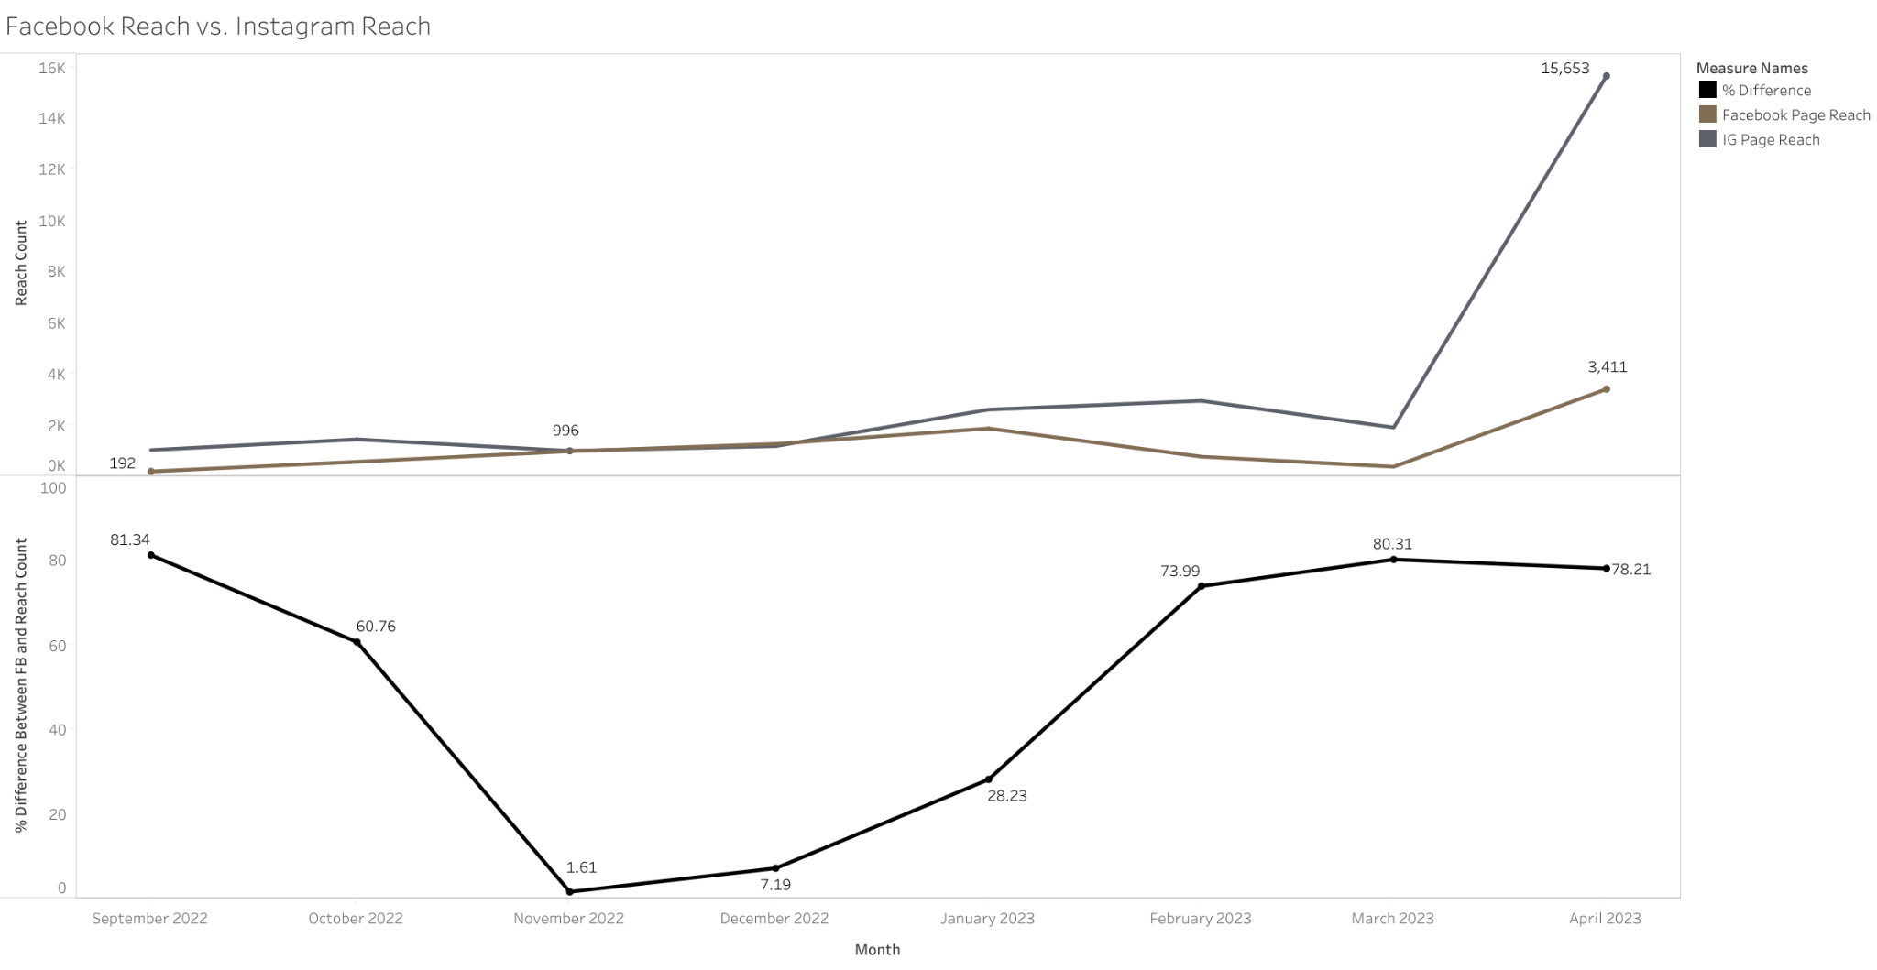
Observations/Insights
November and December 2022 had the lowest difference in reach between Facebook and Instagram
Overall, Instagram tended to reach more people than Facebook did
Social Media Reach
Created w/ Tableau
Notes:
Mariama
Here we have a line graph depicting the level of audience reach between instagram and facebook. In the top graph, you can see that both Facebook and Instagram were performing similarly in terms of how much people your content was exposed to. However, As january, comes, you begin to see instagram performing better than facebook and then surpasses facebook tremendously during the month of March. This means your content performed greater in audience reach on instagram than on facebook.
The second graphs just explains how great the difference in performance was between both social media platforms. The higher the percentage, the the greater the difference between instagram and facebook media reach performance. The lower the percentage just indicates they were both fairly performing similarly. Meaning your content that was being posted on these socials were reaching around the same amount of people.

Slide 11
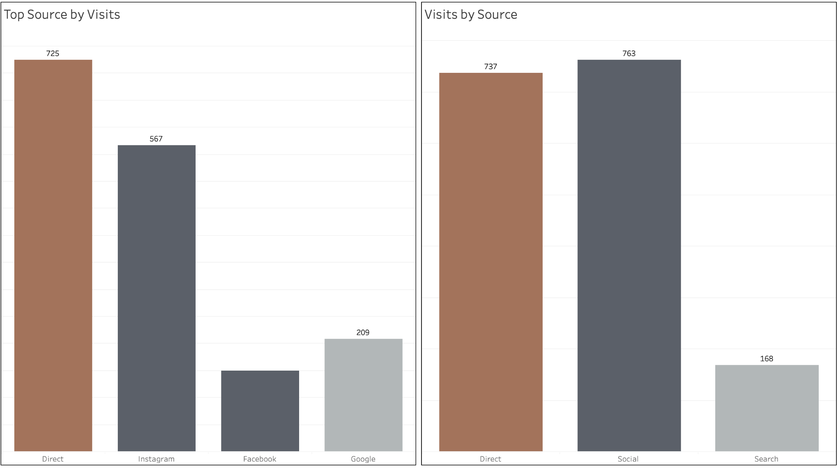
Observations/Insights
Visitors are mainly coming from a social platform, mostly Instagram
Not many visitors are coming from search platform such as Google
Top Sources by Visit
Created w/ Tableau
Notes:
Shawn
The graph on the left shows the top traffic sources by visits. “Direct” visits mean Squarespace could not determine the source of visit, so it categorizes them as direct traffic. This usually indicates someone accessed the website through a browser bookmark, typing the URL directly, or a source other than Instagram, Facebook, or Google.
For non-direct traffic, most visitors came from Instagram.
The graph on the right shows top visits by source. Instagram and Facebook are combined into a “social media” column, which receives the most traffic. Direct visits rank second, while search engine traffic - Google rank the lowest.

Slide 12
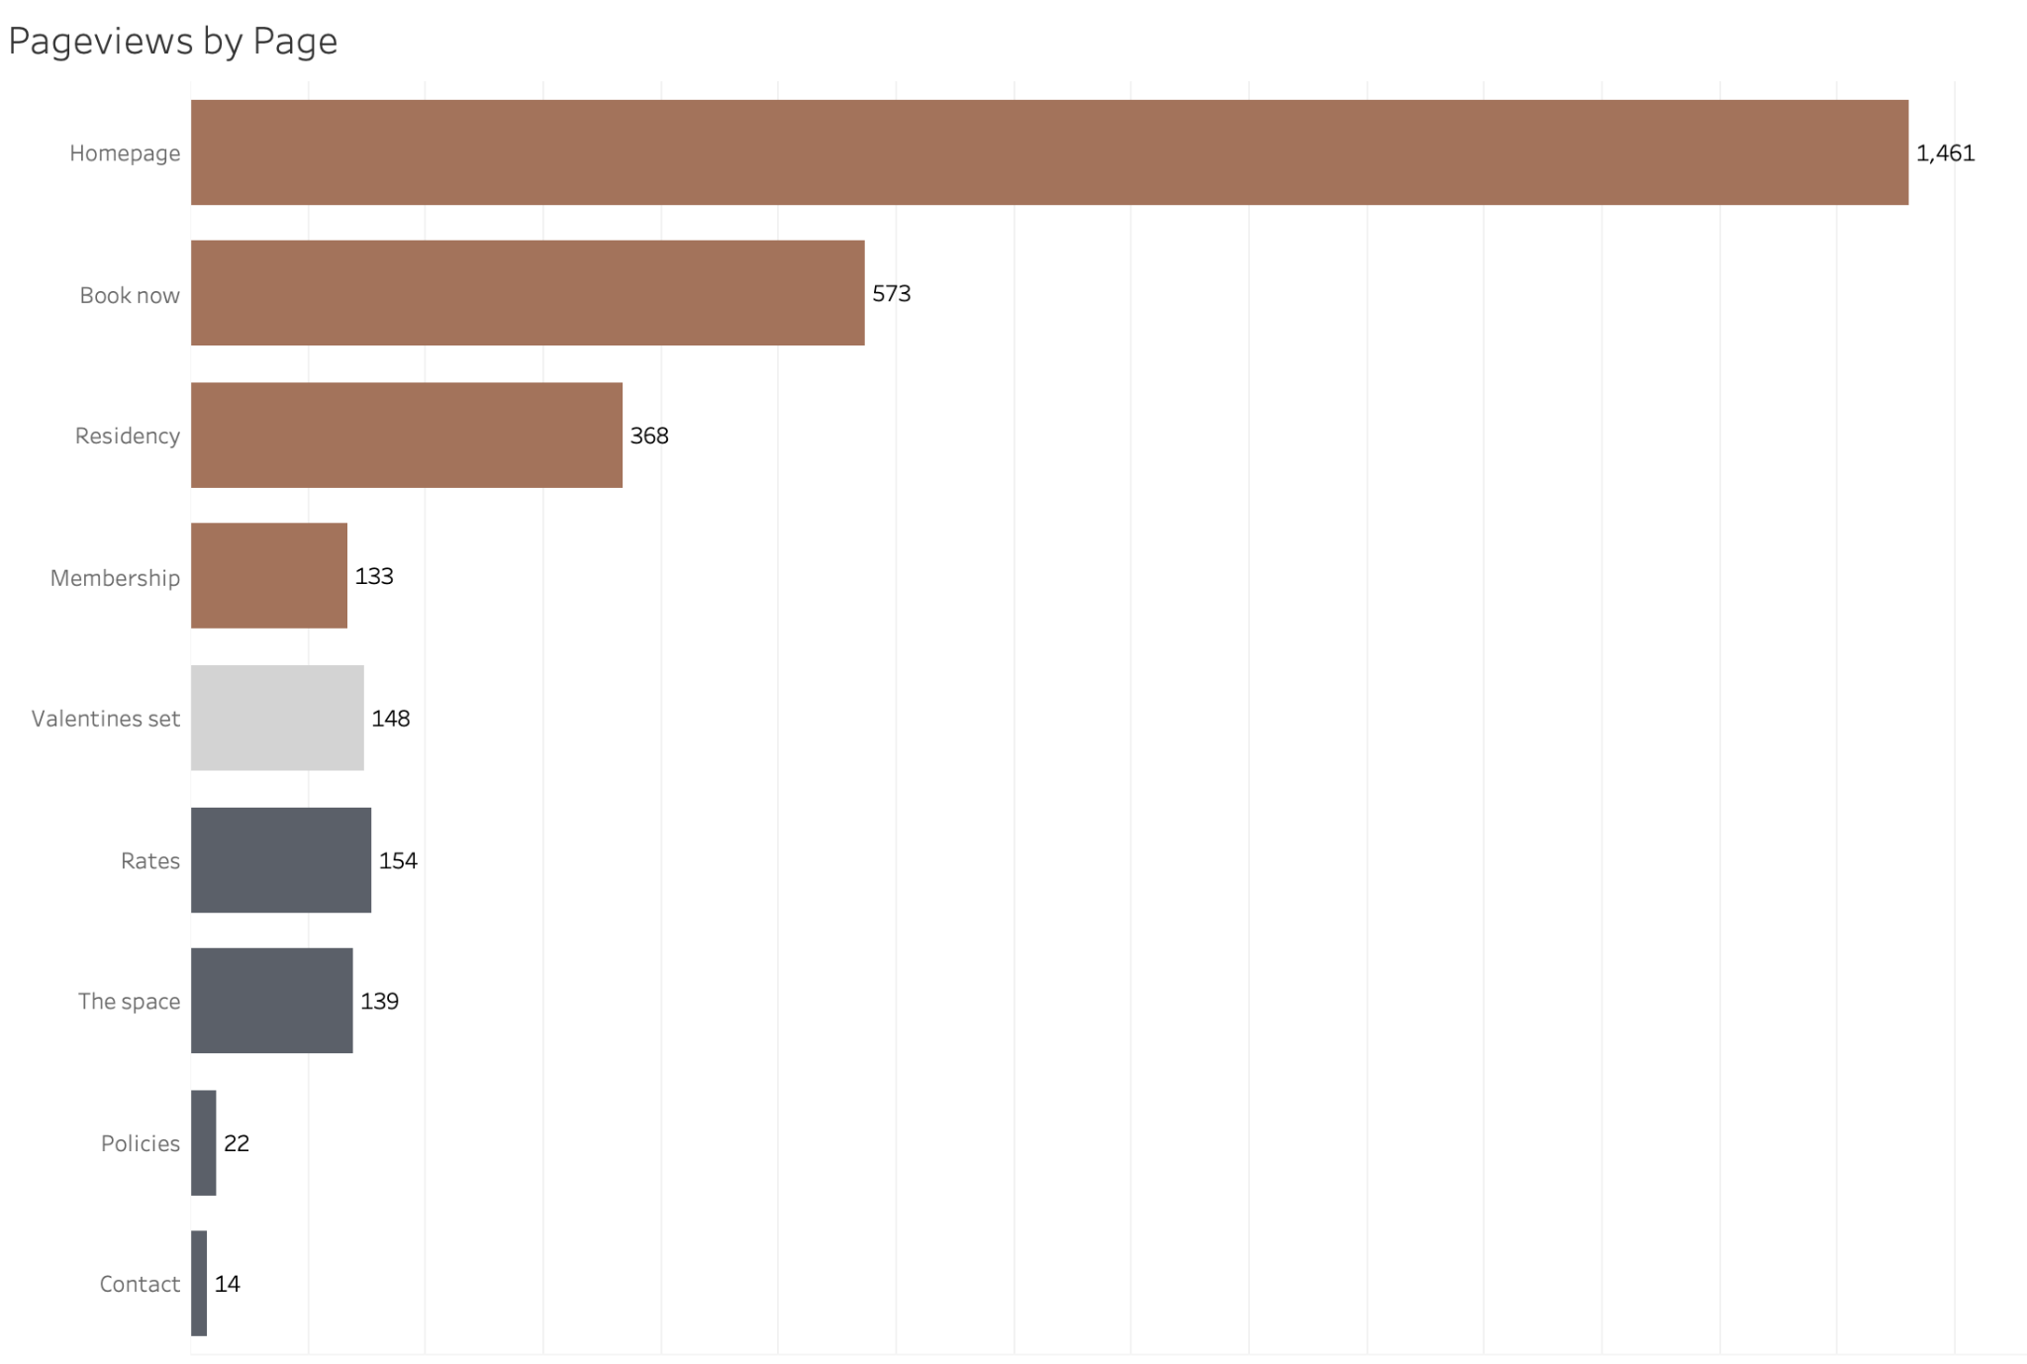
Observations/Insights
Most visitors view the Homepage, Booking page, and the Residency program
Under Info dropdown menu group, Rates and The Space page actually have quite high views
Contact information is available on the Homepage, that explains why it has low view
Old seasonal page Valentines Set receives reasonable amount of views
Pageviews by Page
Created w/ Tableau
Notes:
Shawn
This graph provides an overview of pageviews by page. The brown bars represent pages that feature their own dedicated buttons, allowing user to click on it directly. In contrast, the dark grey bars at the bottom reflect secondary dropdown menu items falling under the “Info” tab, and the light grey bar represent older seasonal page for Valentine’s Day that is no longer on the website.
Overall, pages with their own direct buttons tend to receive significantly higher visits compared to those under dropdown menu. Dropdown items such as Rates and The Space actually have quite high pageviews, However, Contact and Policies is a bit low, contact information is already available on the homepage, that explains why contact page receives such a low amount of visits
Based on these findings, I would suggest give the The Space page and Rates pages their own dedicated buttons in the main navigation. Valentine’s Day page is no longer current, it still receives a reasonable amount of pageviews around the time of promotion, indicating there may be opportunities for seasonal or event-specific content to drive traffic during targeted time periods.

Slide 13
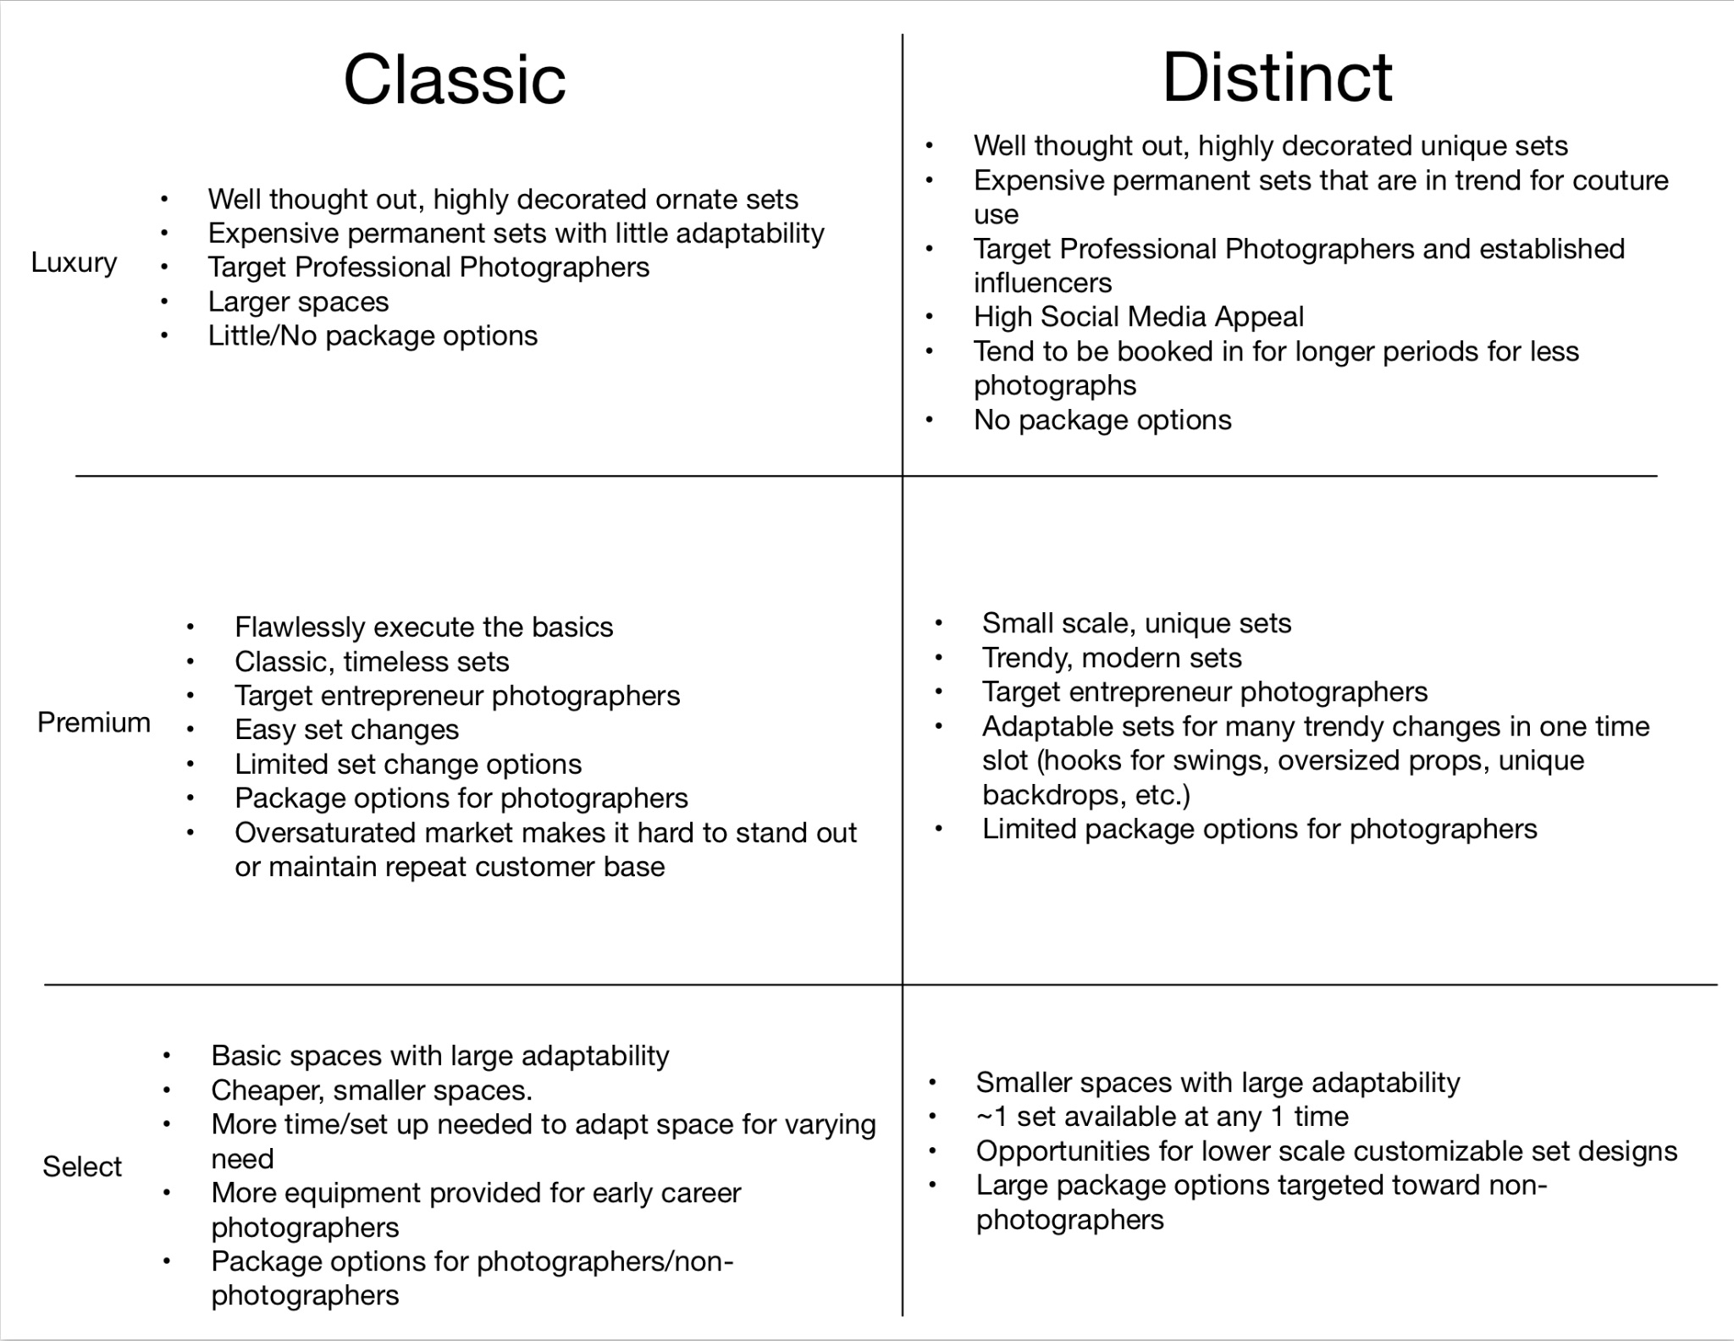
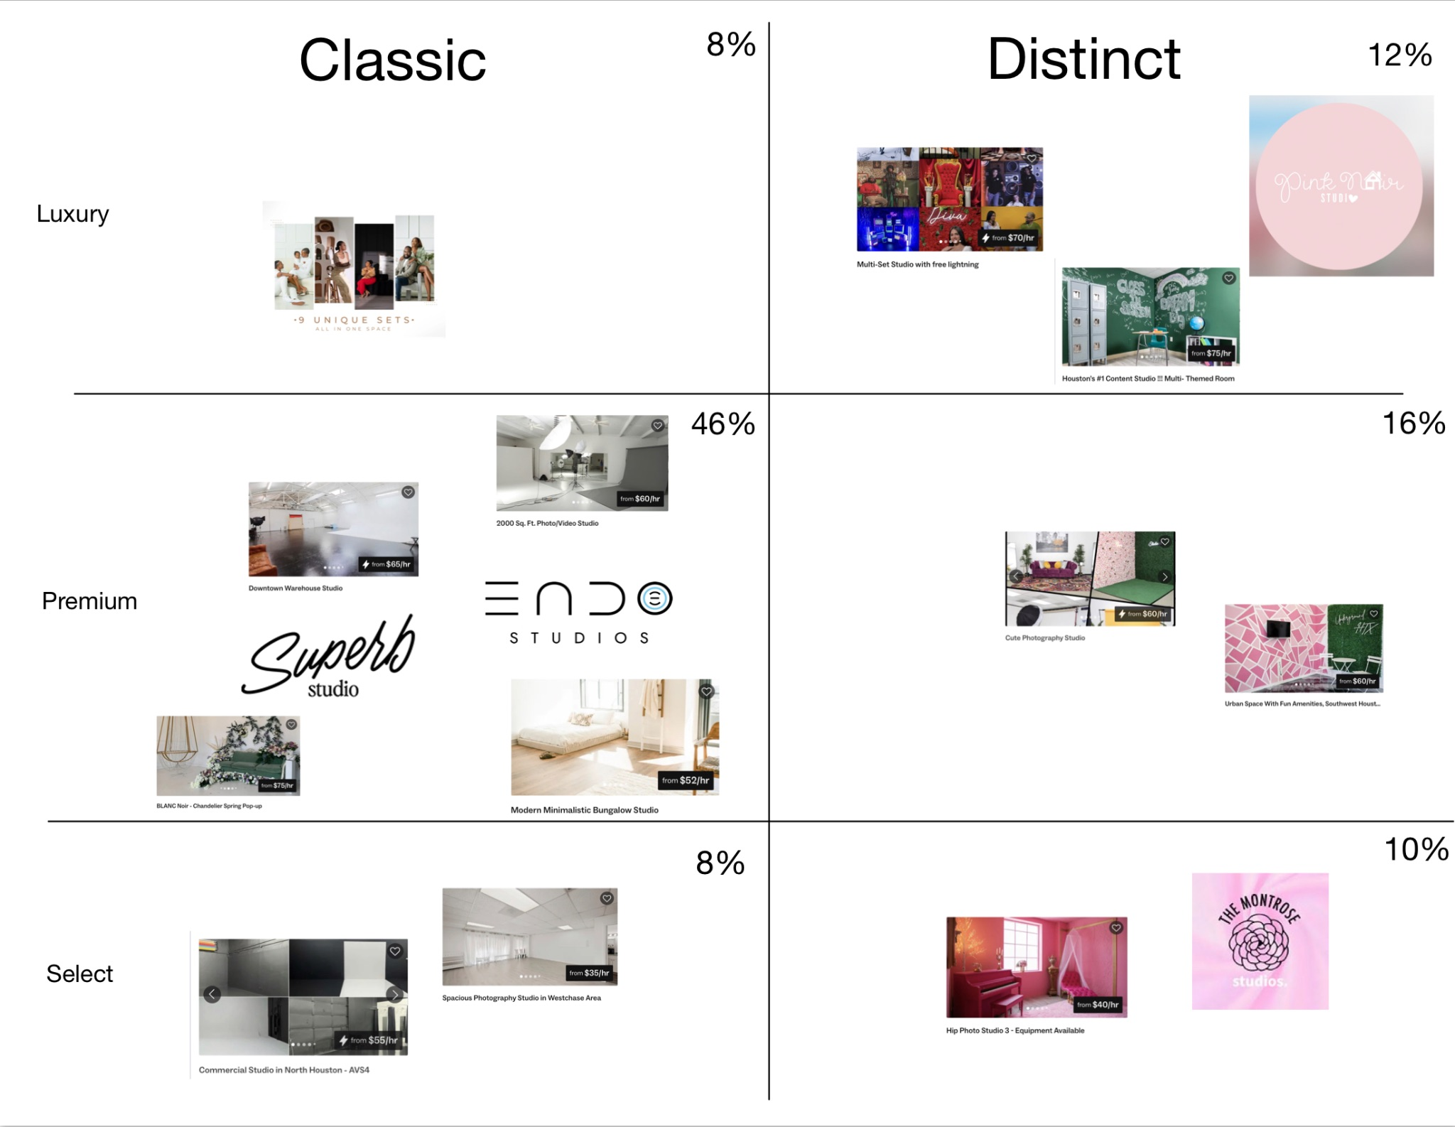
Houston Photography Studio Market
Source: Peerspace
Notes:
Sam
Here we’ve broken up the current Houston Photography Studio Market into 1 of 6 categories. Either classic or distinct. Classic photo studios offering timeless photo backdrops and sceneries such as solid backgrounds, modern home scenes like classy bedroom sets, and muted props such as monochrome cubes and arches. The Distinct studios differentiates itself by instead offering more unique, trendy backdrops and sceneries, such as bright patterns and greenery, stylish charichured scenes like a giant chalkboard classroom, and large, unique props and accessories.
Each one of these categories can be further split into 3 subcategories of Select, Premium and Luxury. I’ve broken down the categories better on the screen. These categories are important because they come the most into play during the non-holiday off-season that you originally asked about. From the table on the right, we can see that the premium classic brand is the most populous brand at 46%. This oversaturation of brand type can make it hard to stand out from your competitors, or to retain a repeat client base since there is SO much inner-brand competition. However, if future capital improvements, focused on expanding into one of the less saturated brand categories, an untapped market for increased client base could be retained.

Slide 14
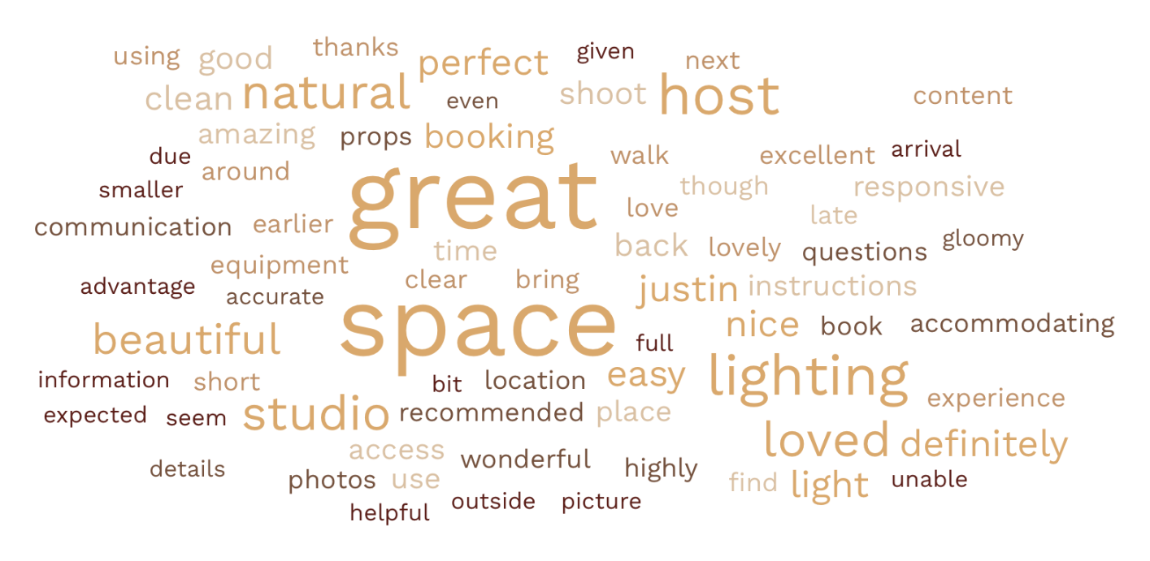
Observations/Insights
Light and Lighting appear at the same frequency as host and Justin
Peerspace Customer Valued Strengths
Created w/ Word Cloud Generator
Notes:
Sammy
This is a chart of the most commonly used words on your peerspace reviews. Generally, all your reviews are positive with the most commonly used word being “great.” This is a easy way to visualize the strengths your company currently has that are most valued by your customers. It is important to note here that the words “lighting” and “light” appear at exactly the same frequency as “host” and “justin.” Meaning that to your current clientele, the natural light your space provides is of similar value to the direct customer service and client contact you provide

Slide 15
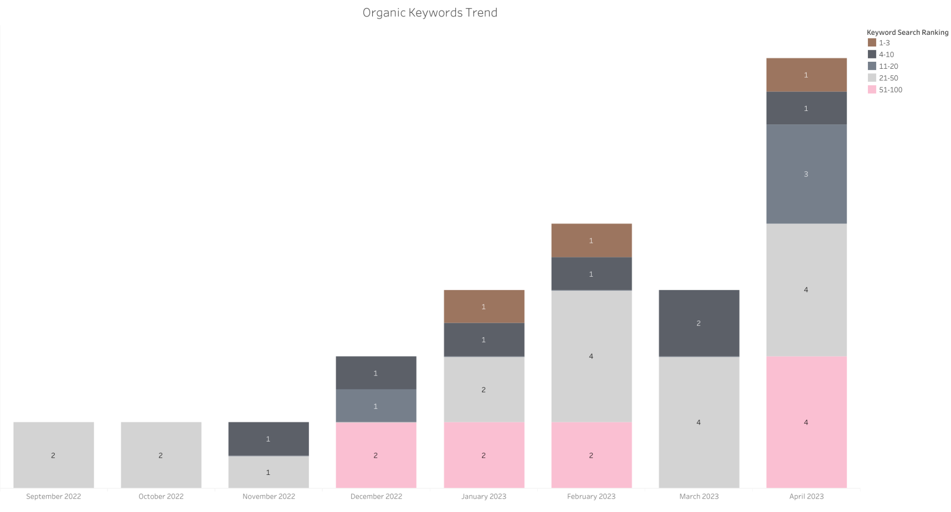
Observations/Insights
Overall positive growth in keyword search rankings
April 2023 had 5 keywords that ranked within the top 20 Google searches
Organic Keywords Search
Source: SemRush
Notes:
Jessie
-The number shown in the stacked bars shows the count of how many keywords searched led to Blank Space Studio’s website being displayed as either the Top 3 searches, 4-11, 11-20, 21-50, and 51-100 on Google Search Engine

Slide 16
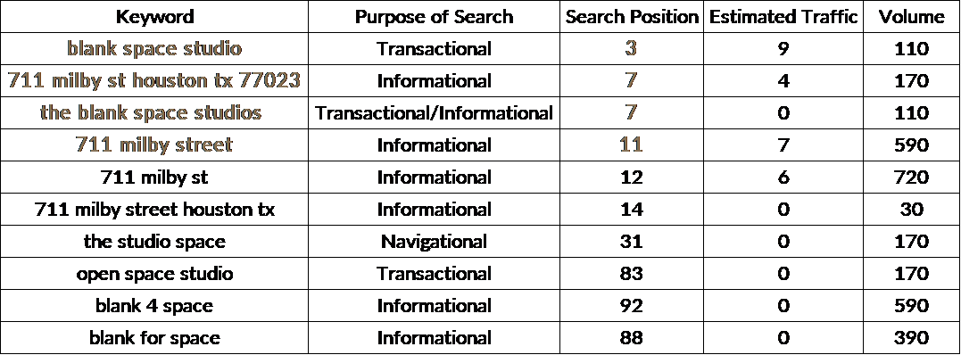
Key
Keyword: The keyword bringing users to the website
Purpose of Search: Search engine algorithm reads and determines the purpose of a search
Search Position: The position of the website displayed on search engine results based on a keyword
Estimated Traffic: Amount of estimated traffic driven to the website based on a given keyword over a specific period of time
Volume: Average number of times users have searched for a given keyword per month
Organic Keywords Search (cont’d)
Source: SemRush
Notes:
Jessie- previous slide is based on these keywords
~Most people searched for Blank Space Studio for transactional or informational purposes.
~The top 3 searches that led to the website were with the keywords: “blank space studio” being in the third 3 result on Google, followed by “the blank space studios” and “711 milby st houston tx 77023” tied for being the 7th search result, and then “711 milby street” as the 11th search result.

Slide 17
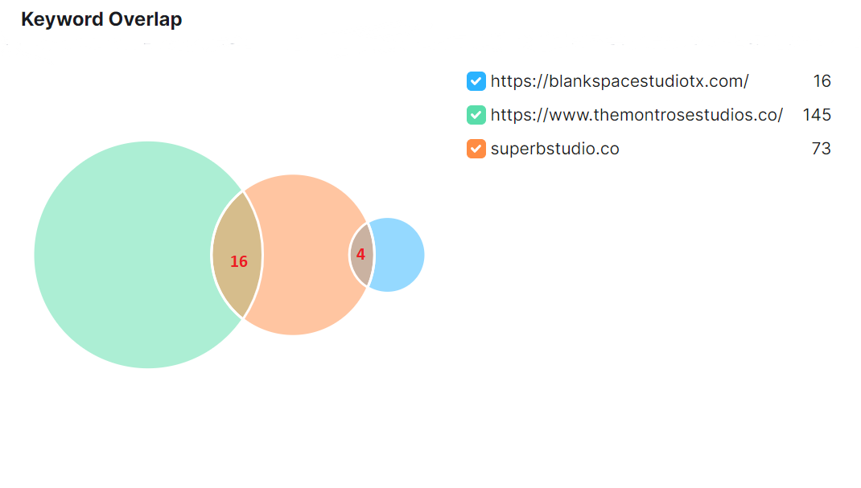
Observations/Insights
4 keywords that lead to both Blank Space Studio and Superb Studio when used in Google search engine
16 unique keywords that lead to Blank Space Studio’s site
Organic Keywords Overlap
Source: SemRush
Notes:
-Superb studio and Montrose studio also share 16 keywords, meaning 16 search words lead to both their sites

Slide 18
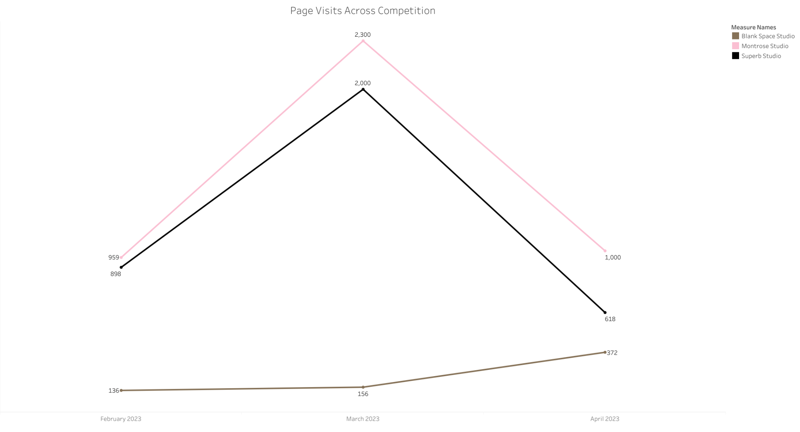
Observations/Insights
In general, competitors have higher page visits
Blank Space experienced an increase in April, likely due to the promotions in April
Page Visits Across Competitors
Source: Similar Web
Notes:
Sammy
Here you can see the page visits your and your competitors main site received between February and April. Your competitors are still at a place where they are receiving a significantly higher page traffic than you. However, it is interesting to note that in March, when both your competitions saw a stark decrease in page traffic you saw and increase to almost comparable levels to them. This is important to note, because in this time you began utilizing April photography promotions. With these promotions you were able to counteract the the off-season site traffic effects your competitors faced, speaking to their effectiveness to increase visibility and site traffic.

Slide 19
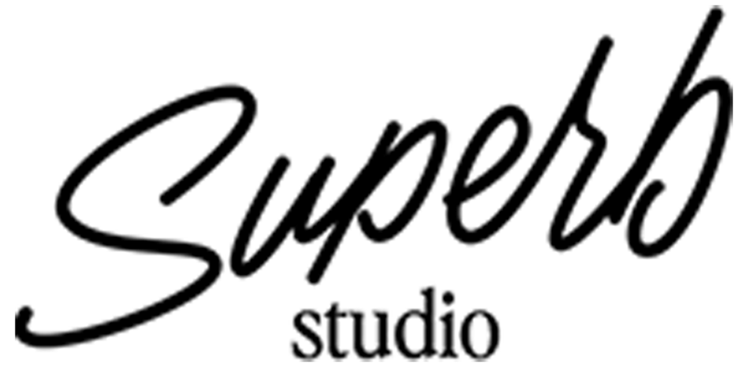
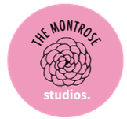
Superb Studio
Provides clients with different locations throughout Houston, TX.
Has newsletter that clients can subscribe to.
Montrose Studios
Offers studio time with in-house photographer included, 4 outfit changes and custom backdrops priced at $351/hr.
Provides classes and mentorship to upcoming photographers and anyone who wants to learn about editing and photography.
Has subscription link on website.
Competitors Strengths
Notes:
Christelle

Slide 20
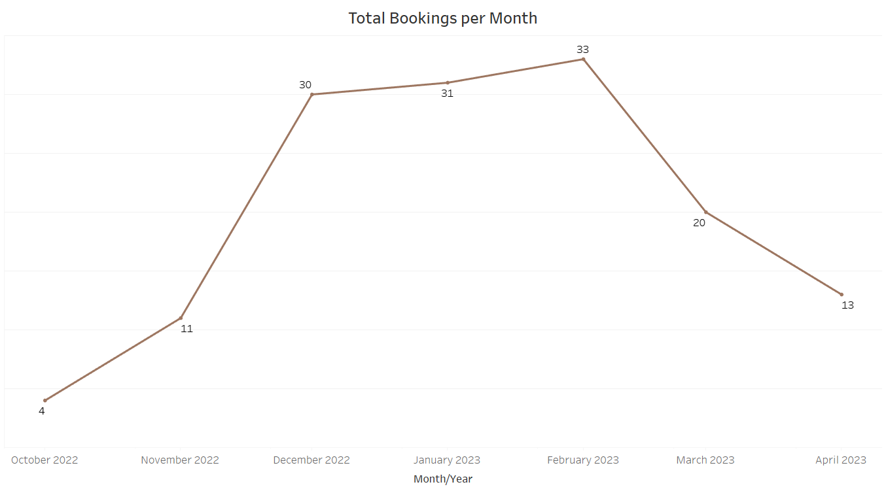
Observations/Insights
Winter Season is highly popular
Spring Season is a slow period
Fall/Summer Season remains to be seen
Bookings by Month
Created w/ Tableau
Notes:
Marco - Total bookings include Peerspace, Squarespace, and Personal booking log. Peak number of bookings is 33.

Slide 21
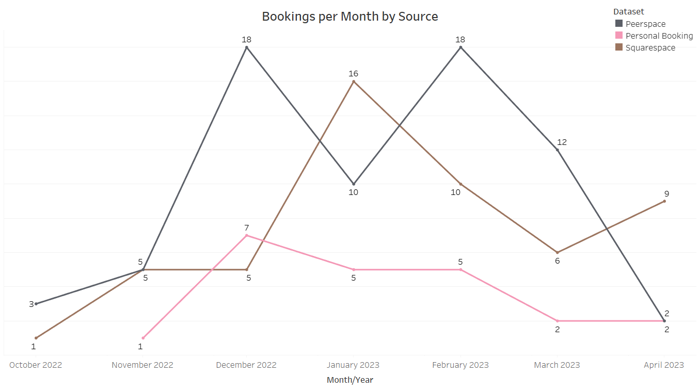
Observations/Insights
Peerspace consistently has the most bookings
Over time, the website gained more traction booking through Squarespace
Bookings by Website
Created w/ Tableau
Notes:
Marco - Peerspace is a platform for creatives and photographers. It is likely their platform is the first go to place for a space. Squarespace can track member usage and further analysis shows more than half of April bookings were from a member.

Slide 22
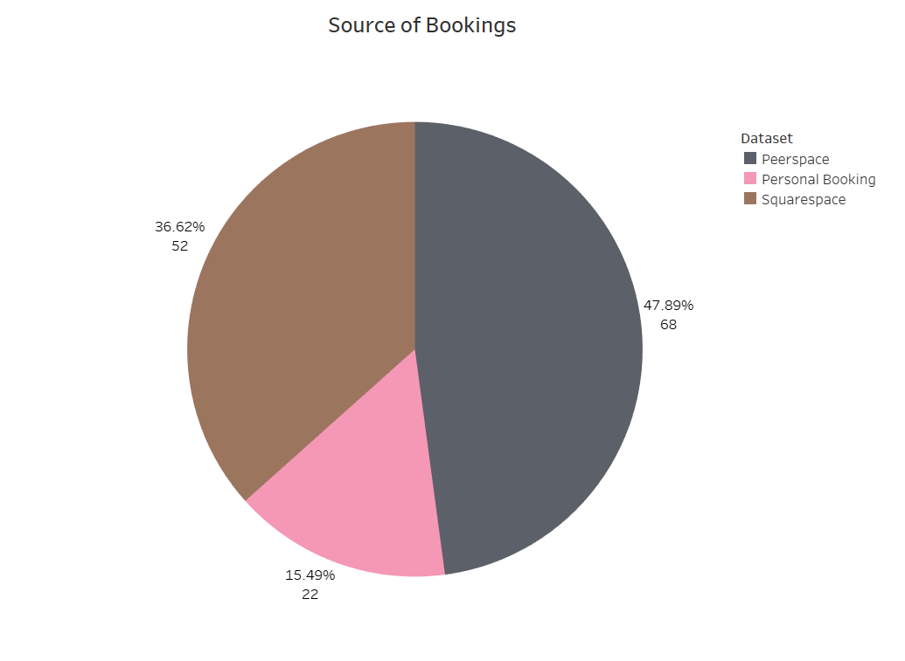
Observations/Insights
Close to 50% of all bookings came from Peerspace
Personal bookings only consist of 15% of total bookings
Total Bookings
Created w/ Tableau
Notes:
Marco - In support of the previous slide, Peerspace make up almost half of all bookings.

Slide 23
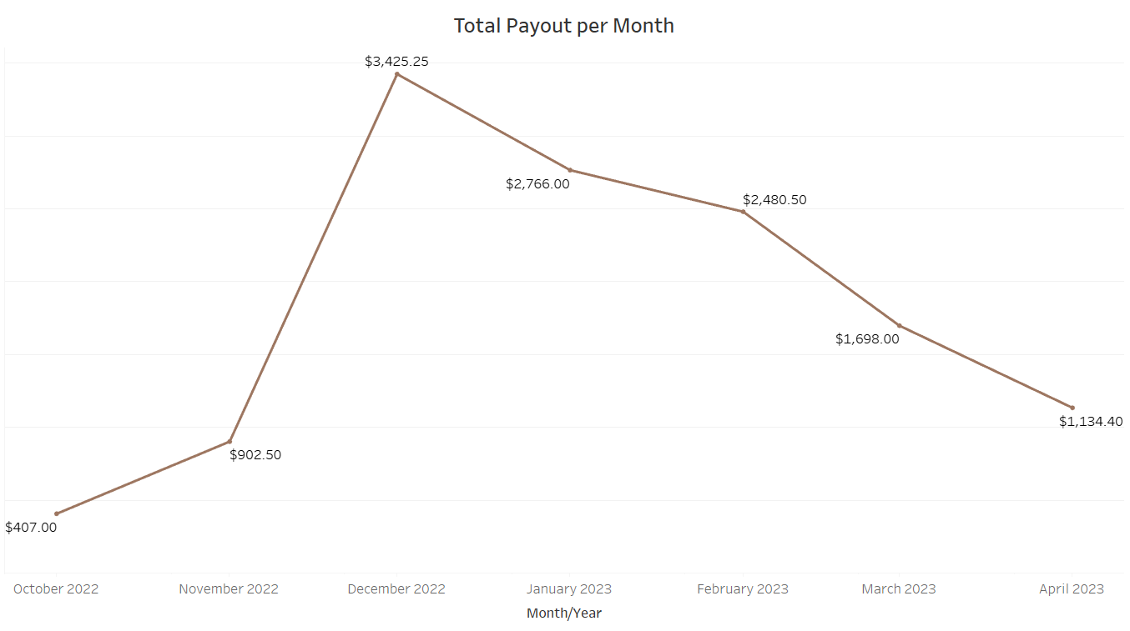
Observations/Insights
Winter season has the most profit likely due to the holiday season
Non-member promotional codes were only used in Nov. and Dec.
Total Payout
Created w/ Tableau
Notes:
Marco - December was our most profitable month, although February had the most bookings. The bookings for December were for longer periods resulting in higher profit margin.

Slide 24
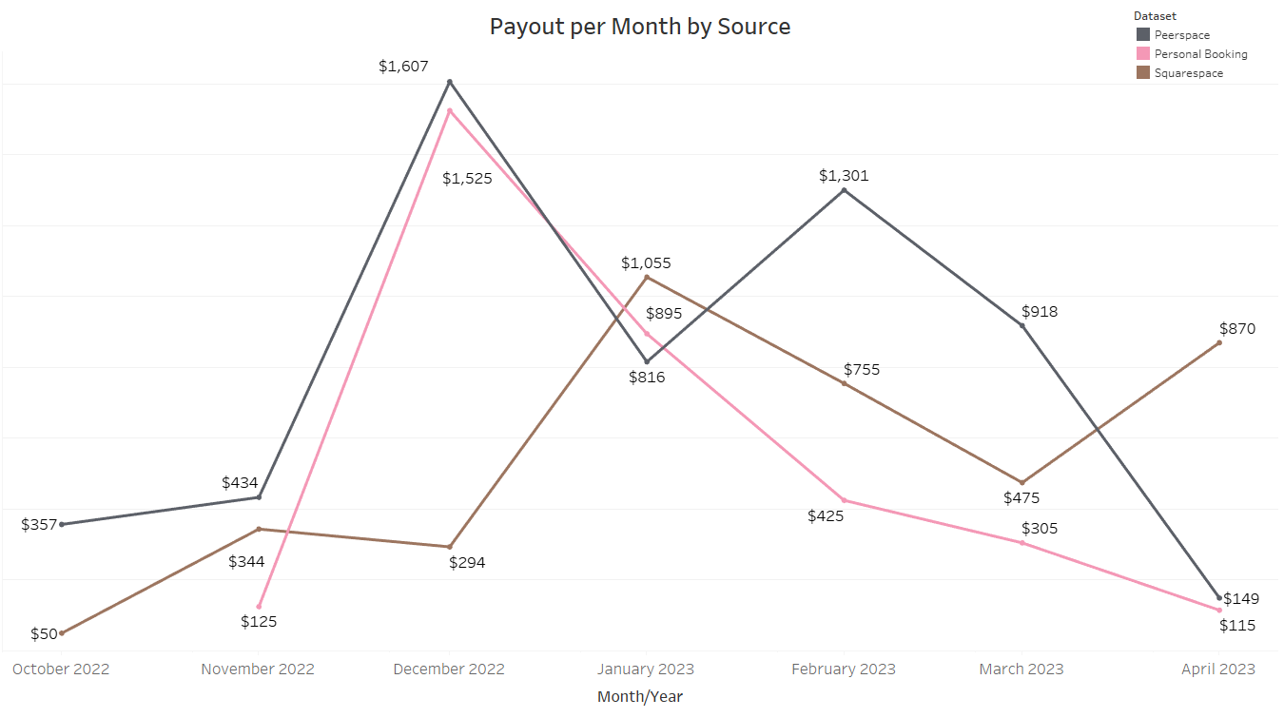
Observations/Insights
Early months, Peerspace and Personal bookings were highest in profit
Overtime profit shifted more to Squarespace
Total Payout by Source
Created w/ Tableau

Slide 25
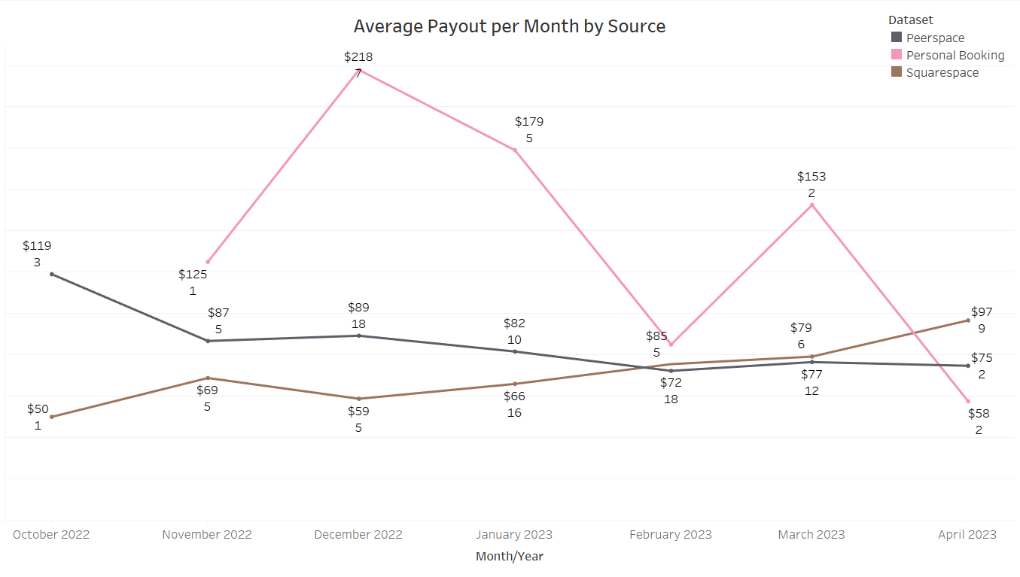
Observations/Insights
Early months, Peerspace and Personal bookings were highest in total profit
Overtime profit shifted more to Squarespace
Average Payout by Source
Created w/ Tableau
Notes:
Marco - Relative to the number of bookings, Personal bookings on average earned more consistently over clients using online websites to book.

Slide 26
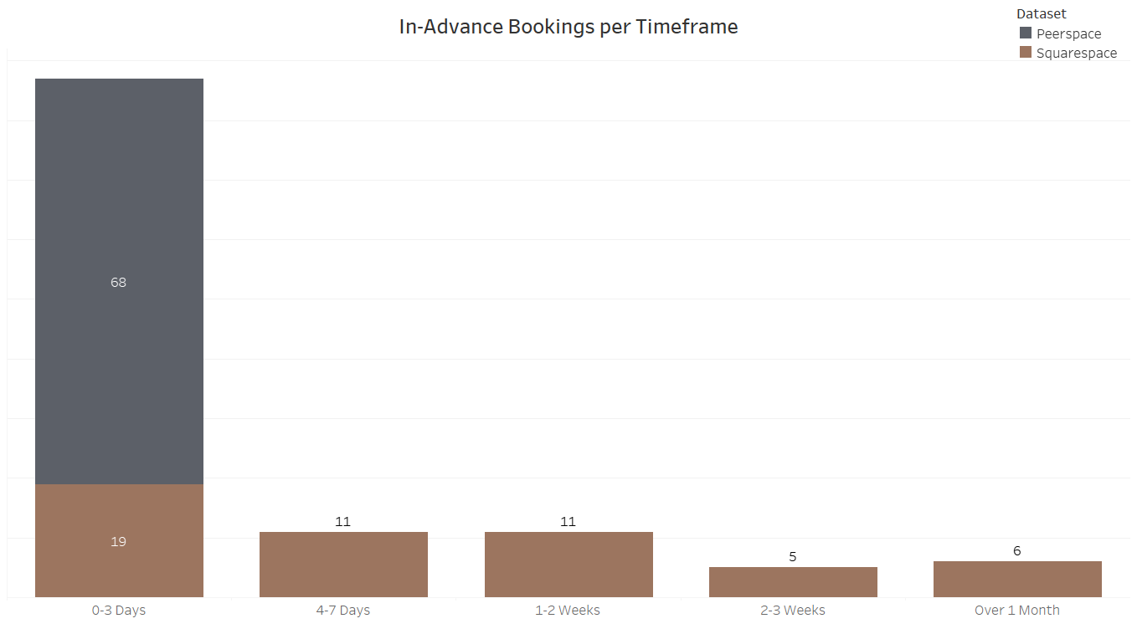
Observations/Insights
Most bookings are made within a week
All 68 bookings through Peerspace are done day of
No data has been collected for personal bookings
In-Advance Bookings
Created w/ Tableau
Notes:
Marco - Planning ahead is important, and the two websites have different clientele with different booking habits.

Slide 27
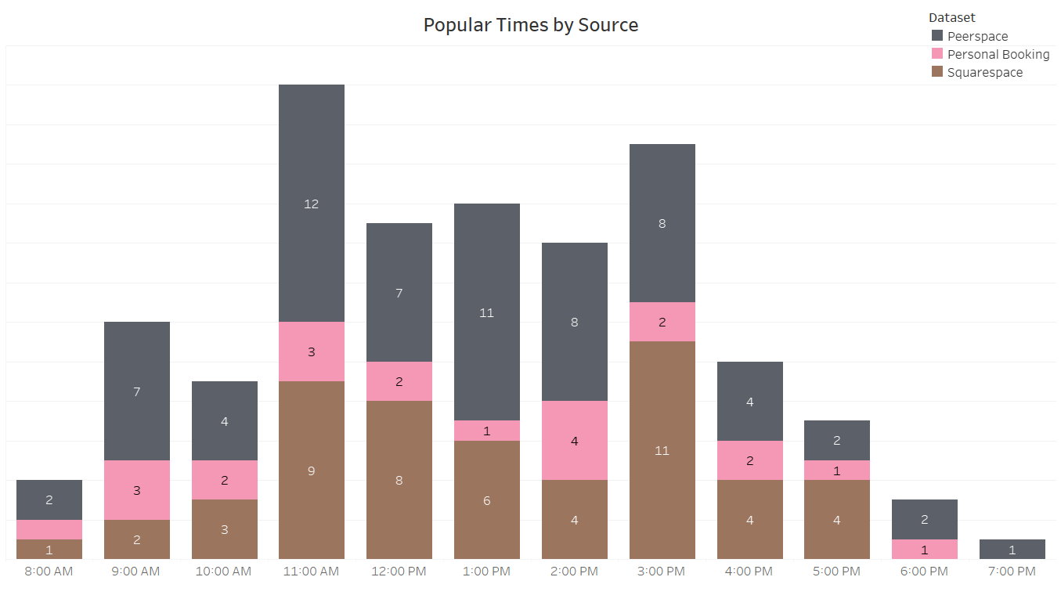
Observations/Insights
Late morning 11:00 AM
Late afternoon 3:00 PM
Peerspace is popular throughout 11:00 AM to 3:00 PM
Squarespace peak popular is at 3:00 PM and spreads out throughout the day
Most Popular Times
Created w/ Tableau
Notes:
Marco - These are most popular times by source, we can see how most of our bookings are mostly in the early morning and mid afternoon. These times might be best based off of natural lighting coming from the windows in the space, also they are just before lunch/dinner times where people take their breaks after an hour long session

Slide 28
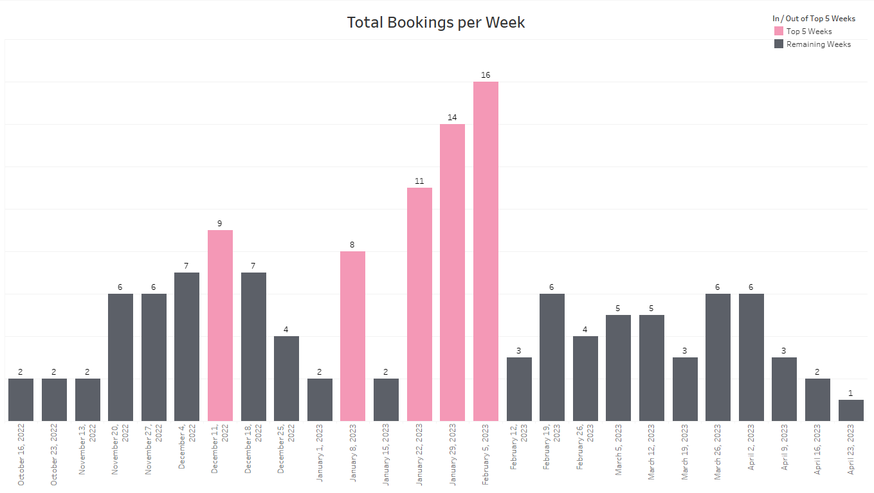
Observations/Insights
Busiest weeks Starting January 22th and Ending February 13th
Peak leading up to December 25th (Christmas)
Peak in week of January 8th New Year celebration
Most Popular Weeks
Created w/ Tableau
Notes:
Marco - We broke down the bookings to each week. have highlighted the top 5 weeks that had the most bookings. we can see how many of our bookings peak a few weeks before major holidays like Christmas, New Years, and Valentines Day.

Slide 29
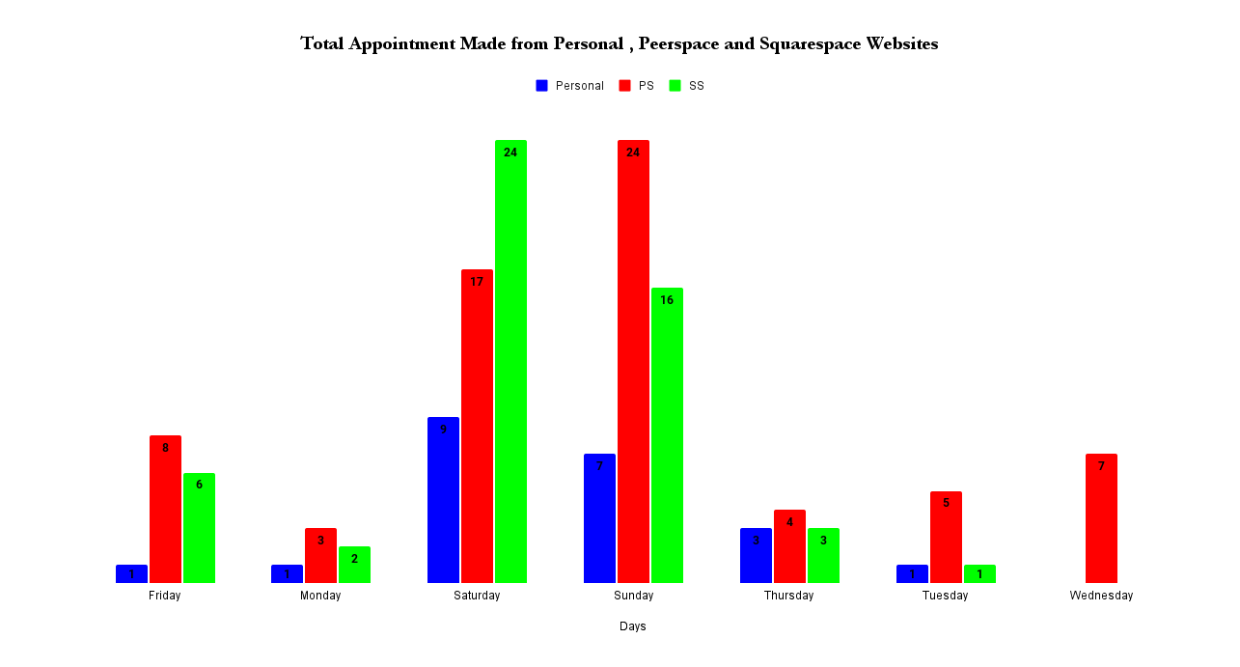
Observations/Insights
Highest booking rates: Saturday from PS and Sunday from SS
Wednesday: No appointment from Squarespace & Personal
Total Appointments by Weekday
Created w/ Excel
Notes:
Tashi

Slide 30
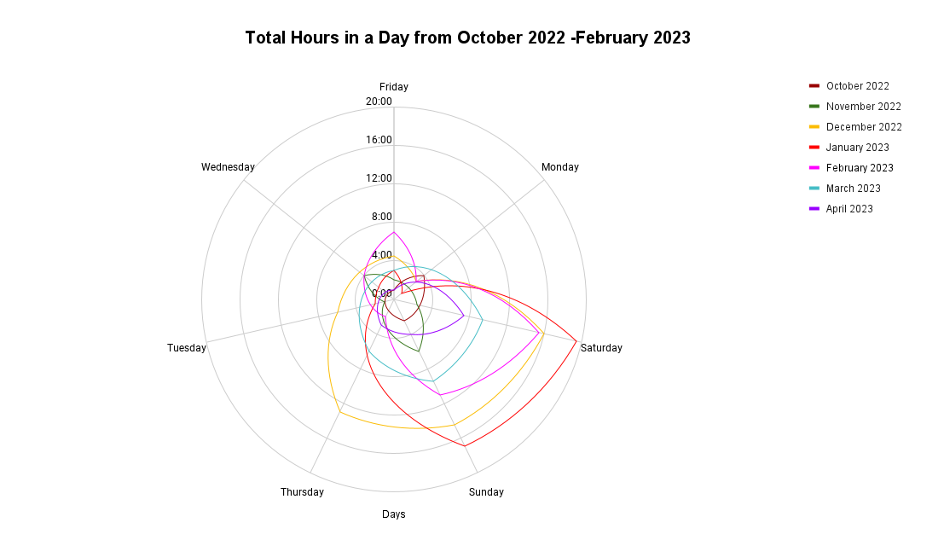
Observations/Insights
Top Three Total Booking hours:
Saturday and Sunday of a month of January 2023; over 16 hours each day.
Thursdays, Saturdays and Sundays of a month of December 2022; over 12 hours each day.
Saturdays of month of February 2023; over 12 hours.
Total Hours by Weekday
Created w/ Excel
Notes:
Tashi

Slide 31
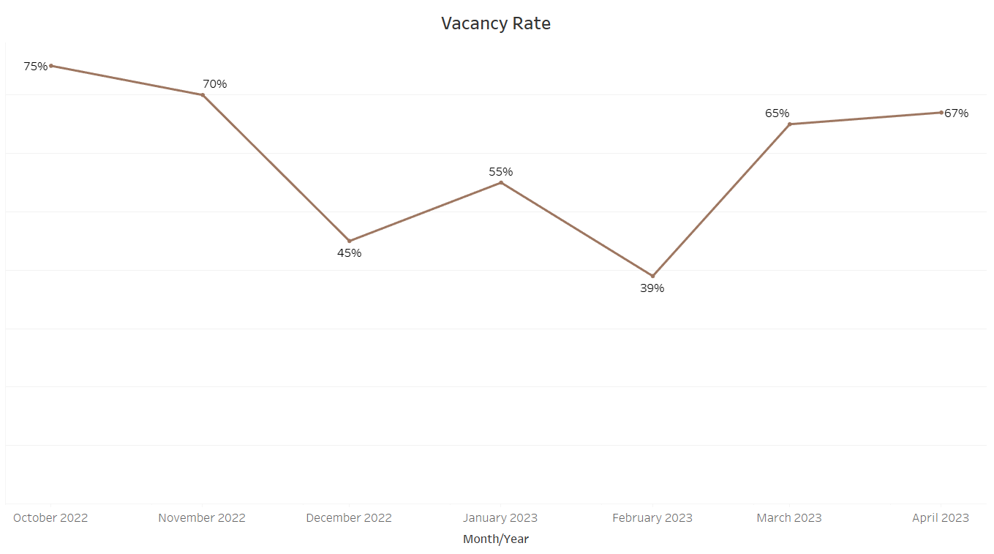
Observations/Insights
Lower vacancy rates are better
Months range from 28 to 31 days
December and February have most distinct days with at least one booking
Vacancy Rate
Created w/ Tableau
Notes:
Marco - The opposite of vacancy rate is occupancy rate which is the opposite percentage listed.

Slide 32
Engagement Strategies

Slide 33
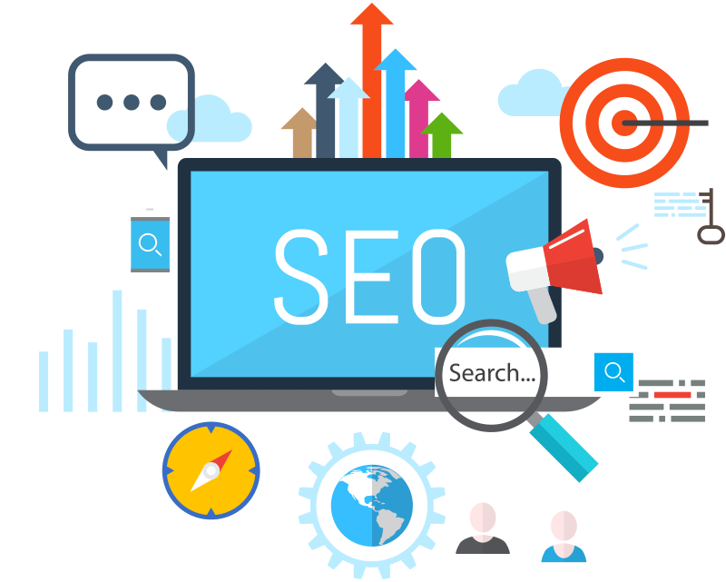
SEO is the strategy of improving a site’s search engine visibility. Utilizing SEO for your website will increase viewership, viewer retention, and engagement.
Search Engine Optimization
Source: Semrush
Notes:
Jessie L- Having a great business is the best thing to achieve, but making sure it is visible and available when potential customers are looking for the service you provide is vital for your business’s growth. That is why we recommend use search engine optimization, or SEO. SEO improves the volume of traffic to your website from search engines such as Google, Bing, and Yahoo.

Slide 34
Search Engine Optimization (cont’d)
Plan, Create, & Optimize content that is of interest to your audience:
Keywords
Throughout website, in metadata, & social media posts
Update Your Content Regularly
Regularly updated content = site relevancy
Use alt tags
Describe your image and video media using alt tags, or alternative text descriptions. They allow search engines to locate your page.
For example, use #blankspacetx, #blankspacehouston
Keep it consistent
Source: Michigan Tech University
Notes:
Jessie L

Slide 35
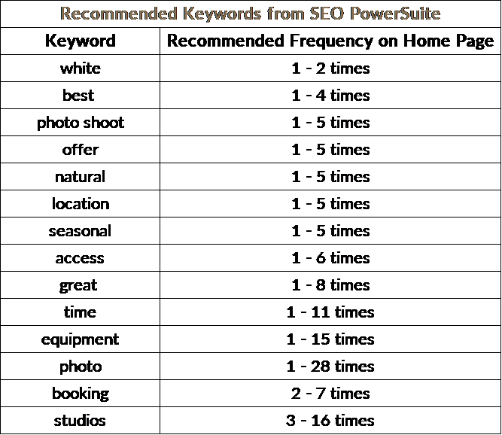
Keywords to Optimize Home Page
Search Engine Optimization (cont’d)
Source: SEO PowerSuite - WebSite Auditor
Notes:
Jessie L - WebSite Auditor from SEO PowerSuite can be used to analyze and optimize SEO elements of a webpage. The recommended keywords generated by WebSite Auditor as seen in the table are based off the tool’s analysis of content from top competitor sites with similar keywords to Blank Space Studio’s homepage. These are keywords that appear exactly on other competitor photography rental sites, but not on Blank Space Studio’s so these are keywords you can consider adding to your homepage . The tool also generated a recommended usage for those keywords to optimize the home page in the search results, which is based on analysis of keyword usage on top competitor sites.
*The recommended keywords and usage of keywords on the homepage are just suggestions and can be changed

Slide 36
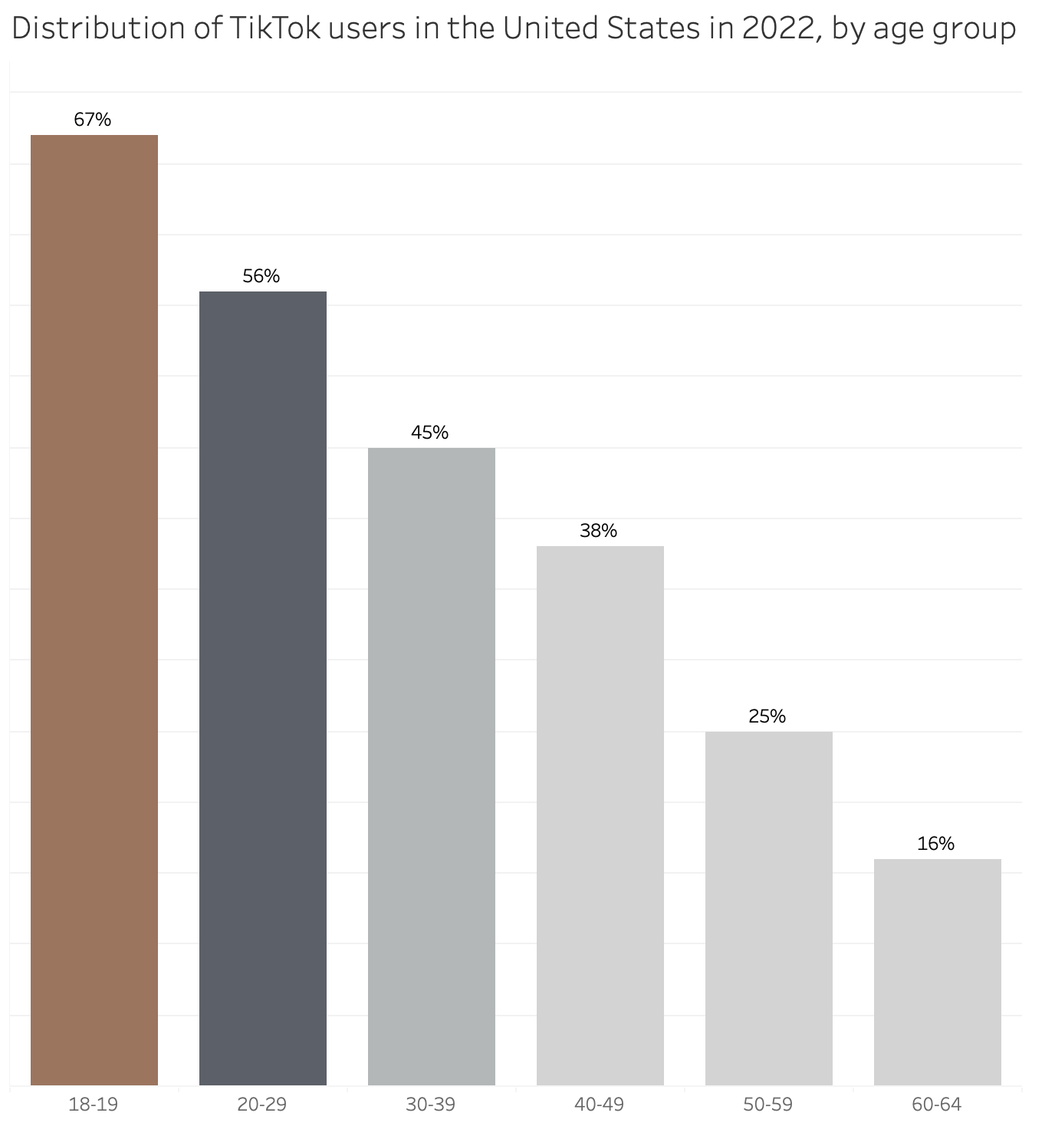

TikTok
TikTok has:
1 billion monthly users worldwide
138 million monthly users in the US
Source: Statista.com
Notes:
Sammy- Tiktok has become a growing platform for photography. It is a starting point for many, and here is why it’s a promising platform. There’s 1 billion monthly user worldwide and of that 1 billion about 138 million are monthly users in the U.S alone. This is a great platform for Blank Space Studio to promote itself and draw in audiences. Currently your main demographic is people ages 25-34. This lend well to tiktok use as the 2nd and 3rd largest age group of people fall within these demographics, with 56% of 20-29y/o and 45% of 30-39y/o saying they used tiktok in a national survey. Additionally, as 67% of 18-19y/o use tiktok. It can be a great way to expand into younger audiences in alignment with your mentorship goals.

Slide 37
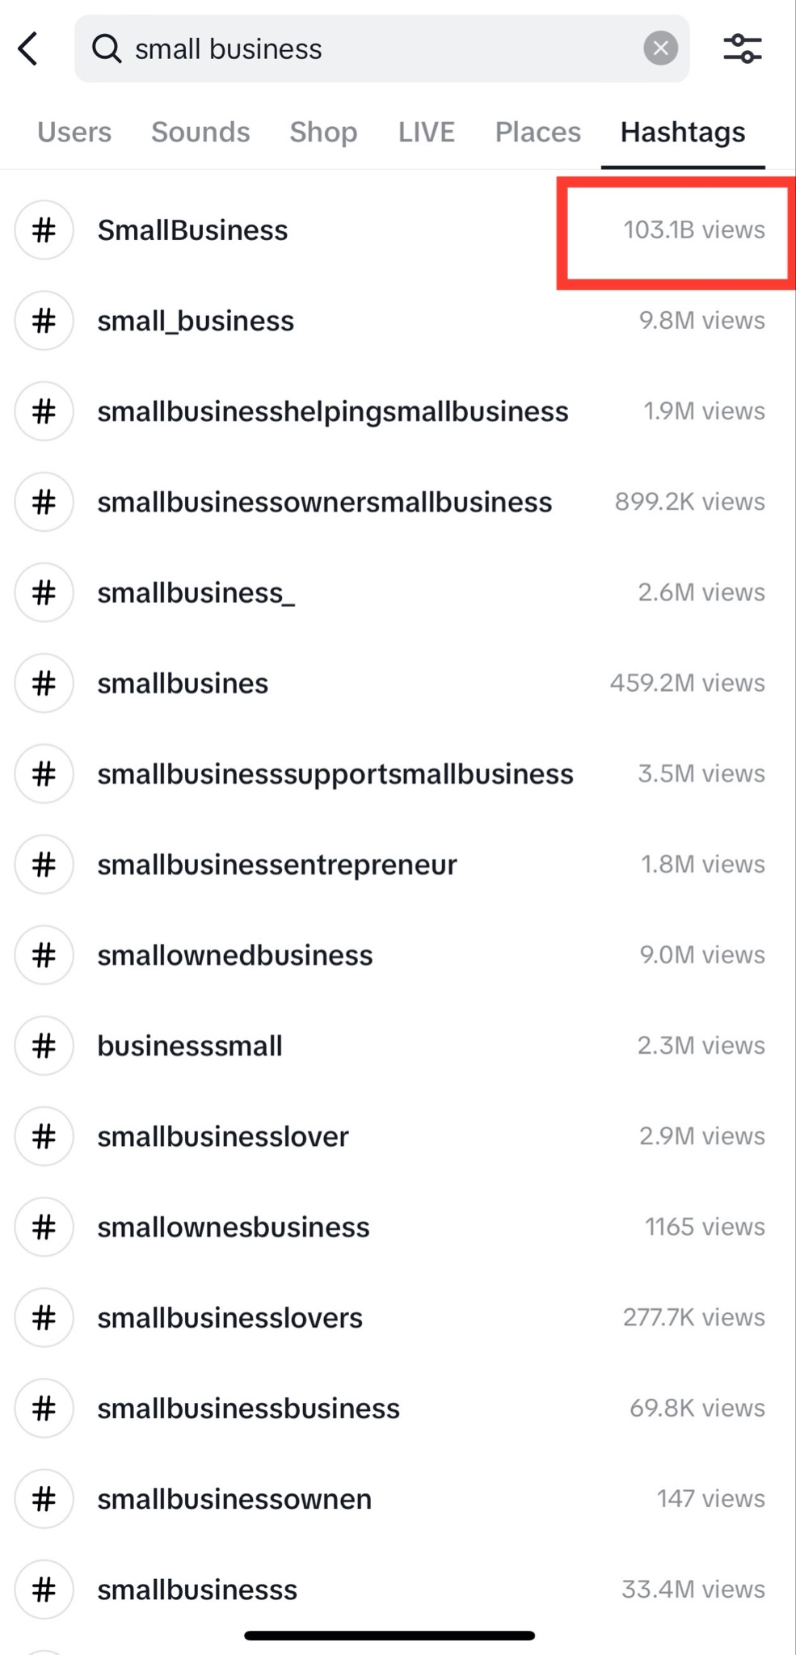
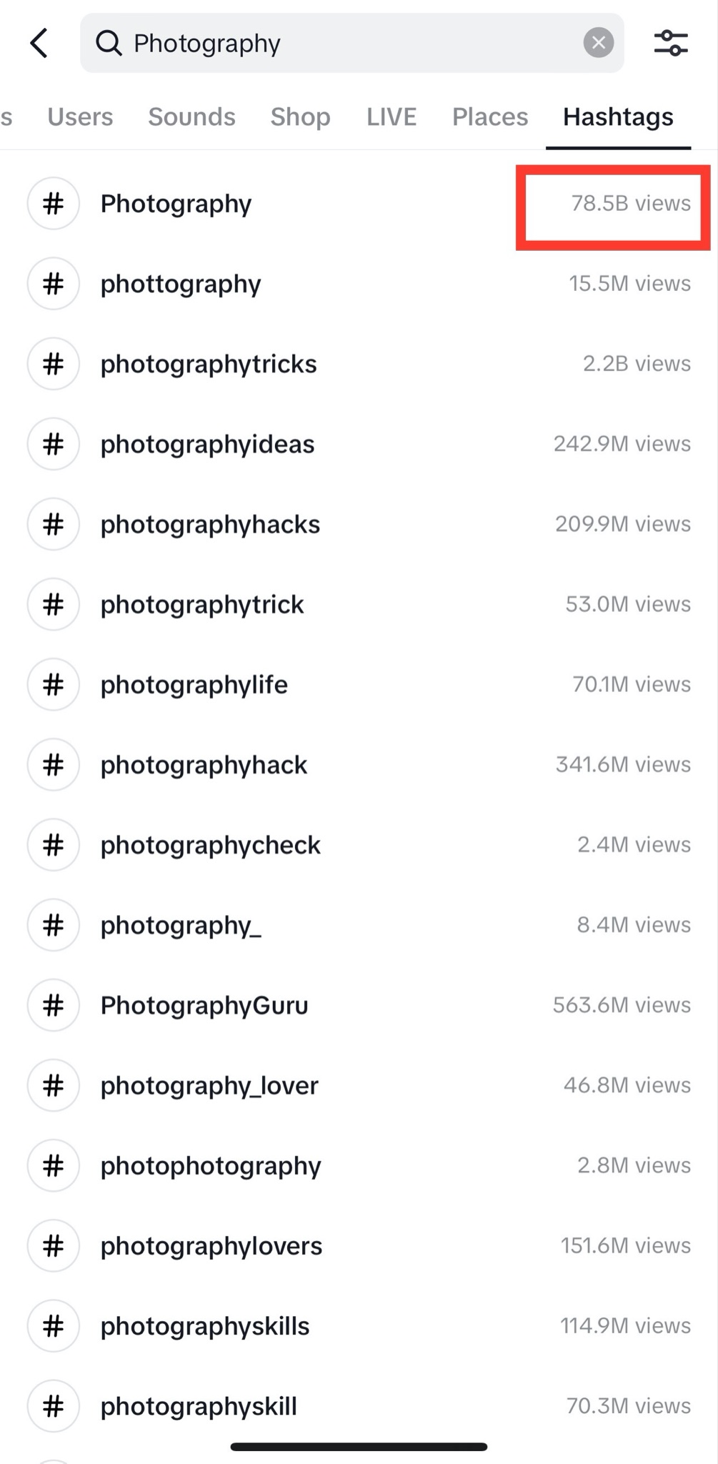
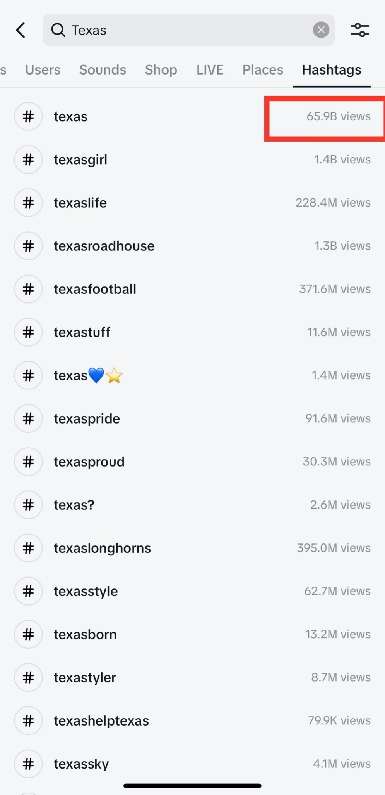
#SmallBusiness
#Photography
#Texas
TikTok (cont’d)
Source: TikTok
Source: TikTok
Notes:
Sammy- For photography studio businesses, TikTok offers a range of opportunities to showcase the potential work and expertise that your photography business can highlight. Small business owners, like you, can leverage the platform to create engaging photo slideshows, behind-the-scenes footage of future sets, or share tips and tutorials on photography techniques and usage of indoor spaces. By doing so, you can help demonstrate your skills and creativity while educating your audience and building trust with potential clients. By incorporating relevant hashtags and participating in popular challenges and trends, small businesses can also increase their visibility and engagement among TikTok's millions of active users. Additionally, the platform's Duet and Stitch features allow users to collaborate with other creators and businesses, providing valuable opportunities for networking, brand-building, and content creation.
Overall: TikTok is an ideal platform for promoting a photography business due to its engaging, short-form video content and active, younger user base. By showcasing your space, collaborating with other users, and leveraging interactive features, photo studio businesses owners, like you, can build on your brand, attract potential clients, and increase your business visibility on the platform.

Slide 38
Determine Posting-Frequency: Analyze your content availability and engagement patterns to determine the ideal posting schedule. Recommend twice a week posting on TikTok, Instagram, and Facebook.
Batch Content Creation: Dedicate specific time slots for content creation. This allows you to maintain a post consistency ready to publish.
Content Themes: Plan a content mix such as client shoots, behind-the-scenes reels, and educational content (editing, posing, and equipment tips). Assign specific themes, or days to provide structure and variety. For example, "Feature Friday" or "Tips Tuesday."
Automate: Utilize social media scheduling tools to schedule posts. Canva will allow you to edit, schedule and post simultaneously on one platform. Keep on track by creating a content calendar on Google.
Implementation Strategy
Notes:
Cassh
Sammy brought up some great points. However, managing all these social media platforms can be a headache on top of your full-time job. Let’s dive deeper into implementation strategies. Consistency is Key!
Creating a posting schedule is essential for increasing engagement and business visibility by staying on top of the algorithm. We want to increase the engagement and retention of current followers while allowing new followers to find you. Resulting in more traffic to your booking site increasing profit. Also, the business promition will allow your audience to learn more about you and your services. Your demographic are more conscious where they spend their money so creating a brand and following is key. I wanted to make this as simple as possible
With 4 Steps to Increase Social Media Engagement:
First, Determine Posting-Frequency: Analyze your content availability and engagement patterns using Instagram Analytics to determine the ideal posting schedule. Recommend twice a week posting on TikTok, Instagram, and Facebook.
Second, Batch Content Creation: Dedicate specific time slots for content creation. This allows you to maintain a post consistency ready to publish.
Third, Content Themes: Plan different types of content such as client shoots, behind-the-scenes reels, and educational content (editing, posing, and equipment tips). Assign specific themes, or days to provide structure and variety. For example, "Feature Friday" or "Tips Tuesday." This will also be a great opportunity to partner with your influencer and photography friends to create some dope content!
Finally, Automation There’s a method to the madness: Utilize social media scheduling tools to schedule posts. There are a lot of social media scheduling tools like Buffer, Hootsuit, etc. however, Canva is my favorite and the easiest. I’ve included a link with steps to utilize this feature. Canva will allow you to edit, schedule and post simultaneously on one platform. You also mention that you already use Google Calendar to keep up with your business schedule. Utilizing the platform to create a content schedule.
Remember, a posting schedule is not set in stone. It should be flexible enough to adapt to changes in audience behavior, social media algorithms, and trends. Regularly review and refine the posting schedule based on data and audience engagement to optimize the algorithm as much as you can to stay on their feeds.
Now I’ll pass it over to the rest of my team to drive deeper into how you can increase your revenue.

Slide 39
Revenue Strategies

Slide 40
Custom sets for clients tailored by interior designers or other photographers
Possible photography services and photography equipment
Existing or anticipated amenities such as air conditioning, a coffee station, or wardrobe support
Leverage the perks of being within the EaDo neighborhood
Services and Perks
Notes:
Marco - Explore the services offered by your competitors and if it works for your business model. You can add competing prices or a unique perspective for photography. This is also a way to diversify your revenue sources. Advertise your existing amenities or invest in new ones. Perks such as a coffee machine, a wardrobe, a comfy couch, a small fridge encourages people to book for longer for a small price. Join a growing community of photographs and creatives around EaDo.

Slide 41
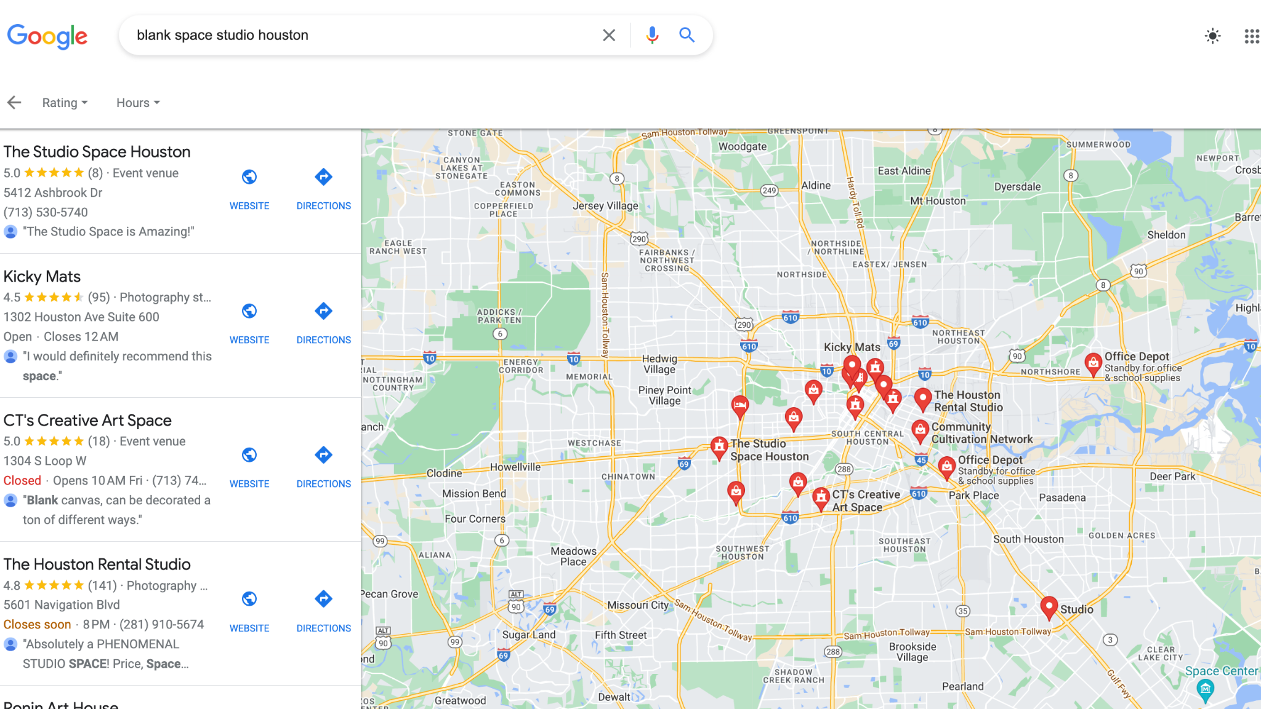
Google
Verify your business on Google
Put it on Google Maps
Notes:
Jessie He:
Google is such a great way to advertise your company and engage with your customers. Let me tell you know, it is free to set it up. You can manage business information such as location, time, and photos. You also get something call Google Insight, where you get reports on what action they do when they find your listing.

Slide 42
Conclusion
Notes:
Lionel Now Jan, Yes, the Dataset you provided contained data from August 2022 to April 2023 but what does that mean for the future of your data!?
We have some great insights and Recommendations populated for you
Thats right there’s no need for any additional screenshots!

Slide 43
In general, Instagram content has a greater reach compared to content on Facebook
Top most viewed website pages are the Homepage, Booking and the Residency page
Peerspace clients are the majority of bookings but personal bookings make a higher profit on average
Clients mostly book one or two weeks before the holidays
More than half the time the space is being underutilized
Promotional codes are rarely used and conflict with generated codes for Members
Insights
Notes:
Lionel

Slide 44
Develop/Use a system to track returning clients
EX: CRM (Customer Relationship Management System)
Create a content calendar and list major holidays at the top of the year
Incorporate discounted/deals on weekdays
Post promotional deals on all socials a few weeks in advance
Invest in social media campaigns (TikTok, Instagram, and Facebook)
Partner with local influencers to advertise the space
Use of hashtags and keywords to increase visibility when sharing content
Create a subscribe link on main website and send out bi-weekly/monthly newsletters with reminders and creative ideas about photography from Blank Space Studio
Recommendations
Notes:
Lionel- Here are the gems we promised!
To track returning clients for a business, implementing a customer relationship management (CRM) system is recommended. The system involves collecting and storing customer data for tailored communication, such as customized offers and creating a positive customer experience to encourage repeat visits. Popular CRM platforms include Salesforce, HubSpot my personal favorite, Zoho CRM, and Microsoft Dynamics. With a CRM system, valuable insights can be gained into a customer's buying patterns to continuously improve their experience and better meet their needs over time.

Slide 45
Thank You!
Any Questions?

Slide 46
https://www.similarweb.com/website/superbstudio.co/#overview
https://www.similarweb.com/website/themontrosestudios.co/
https://www.semrush.com/analytics/organic/overview/?db=us&q=blankspacestudiotx.com&searchType=domain&date=20230603
https://www.mtu.edu/accessibility/training/images/
https://www.statista.com/statistics/1095186/tiktok-us-users-age/
https://www.semrush.com/blog/what-is-seo/
https://www.investopedia.com/articles/personal-finance/051815/pros-cons-using-coupons-your-business.asp
Resources

